Slide 1








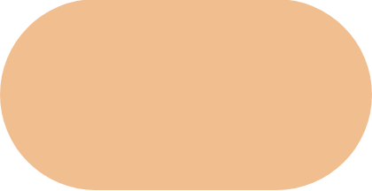







Customer Segmentation for Strategic Marketing
A CRISP-DM Approach to Optimizing Mall Customer Value
VIPs
Potentials
Standard
Impulsive
Savers
High Income, High Spend
High Income, Low Spend
Low Income, High Spend
Low Income, Low Spend
Mid Income, Mid Spend
Business Understanding
→
Data Understanding
→
Data Preparation
→
Modeling
→
Evaluation
→
Deployment
Presented by: Emre Şentürk - Göktuğ Deniz Sert - Mehmet Safa Akın - Şevval Öner - Yağmur Ağaçbacak

Slide 2


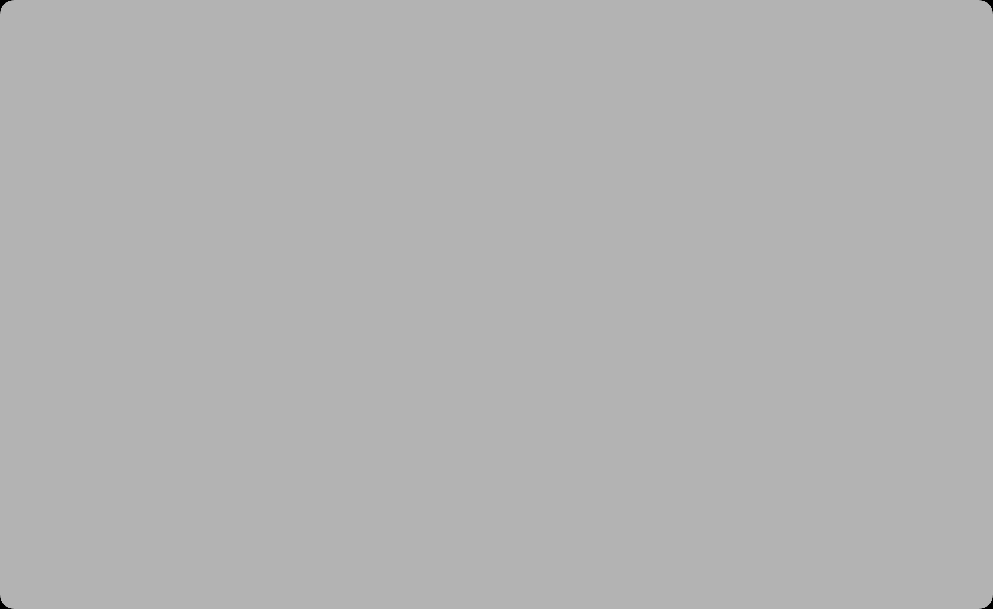
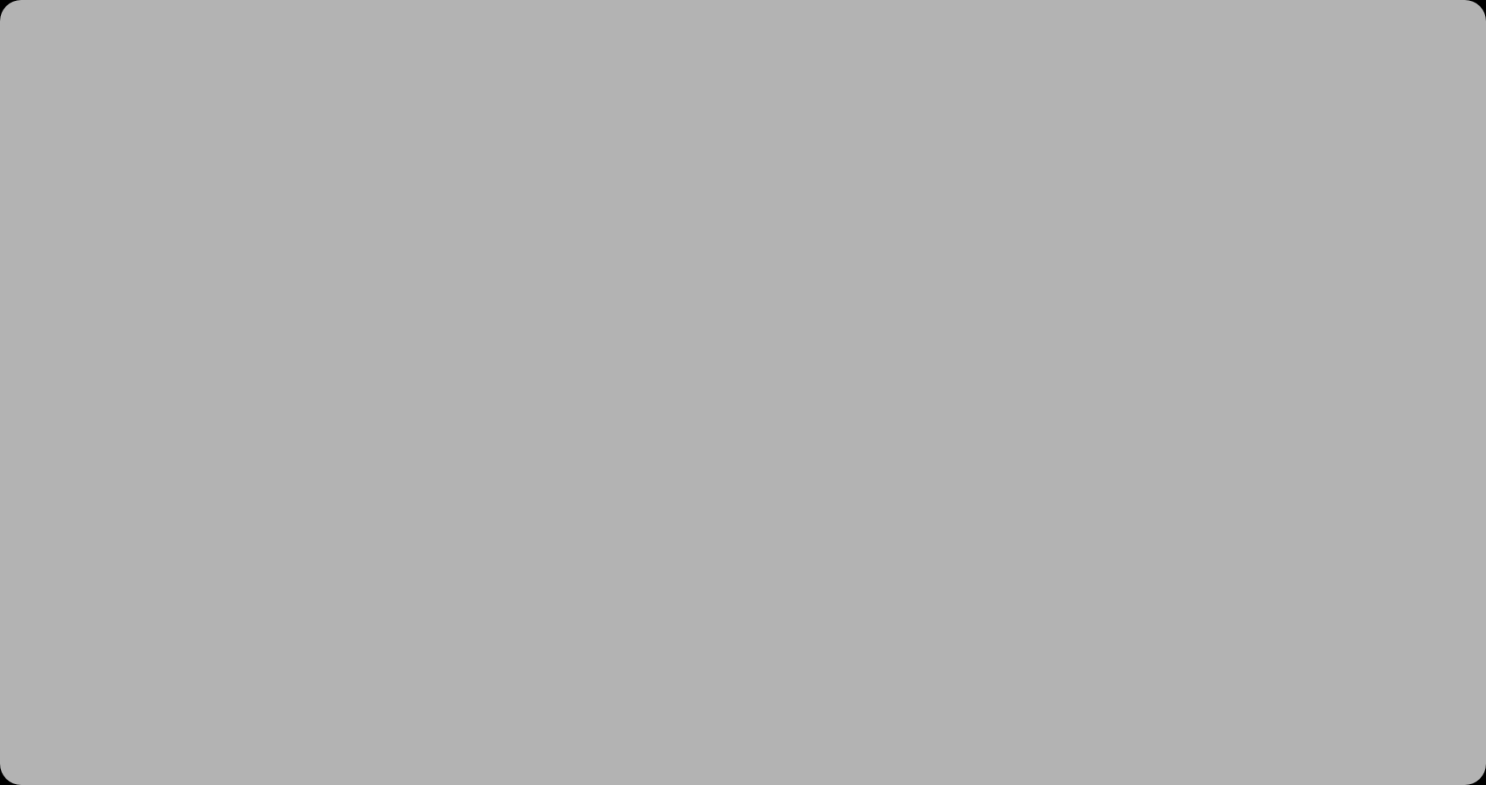














Project Introduction
The Challenge
Our Approach
Mass Marketing Approach
Data-Driven Segmentation
The mall's marketing department currently uses a "mass marketing" strategy, sending the same offers to everyone
Apply unsupervised learning to transform raw data into actionable customer segments
Behavioral Analysis
Inefficient Conversion
Focus on spending behavior rather than just demographics to create meaningful segments
This lack of personalization leads to lower conversion rates and fails to reward loyal high-spenders
Targeted Strategies
Missed Opportunities
Develop specific marketing approaches for each customer segment to optimize ROI
The mall treats every customer the same, missing opportunities with high-value clients and wasted resources on low-potential ones
Our goal is to help the mall transform from intuition-based marketing to data-driven targeted strategies

Slide 3
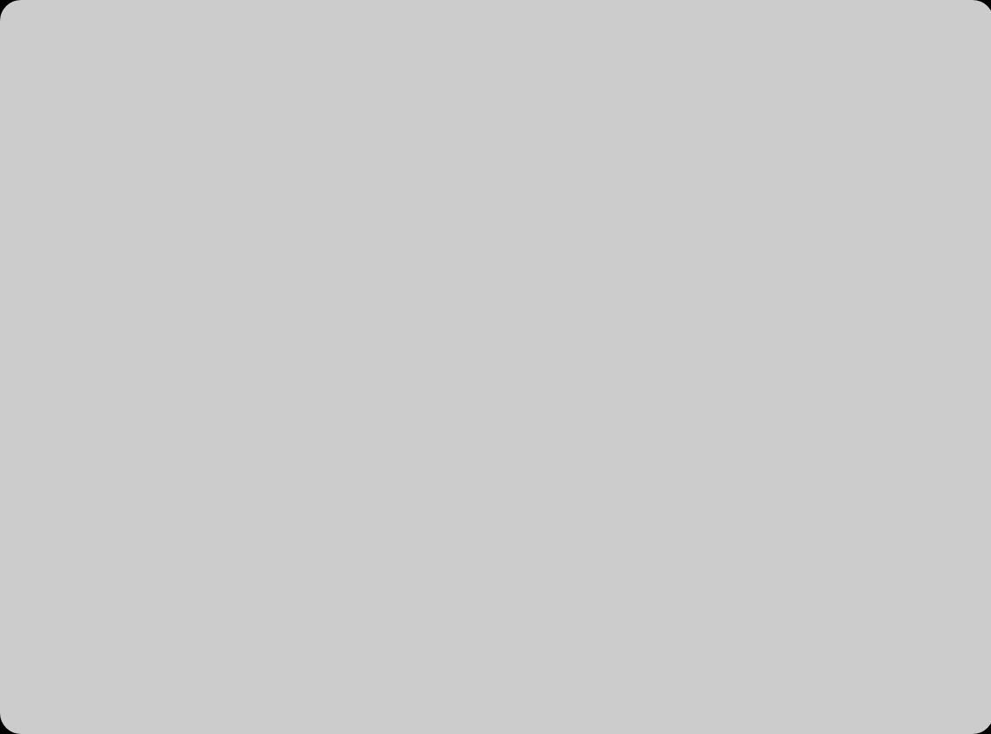
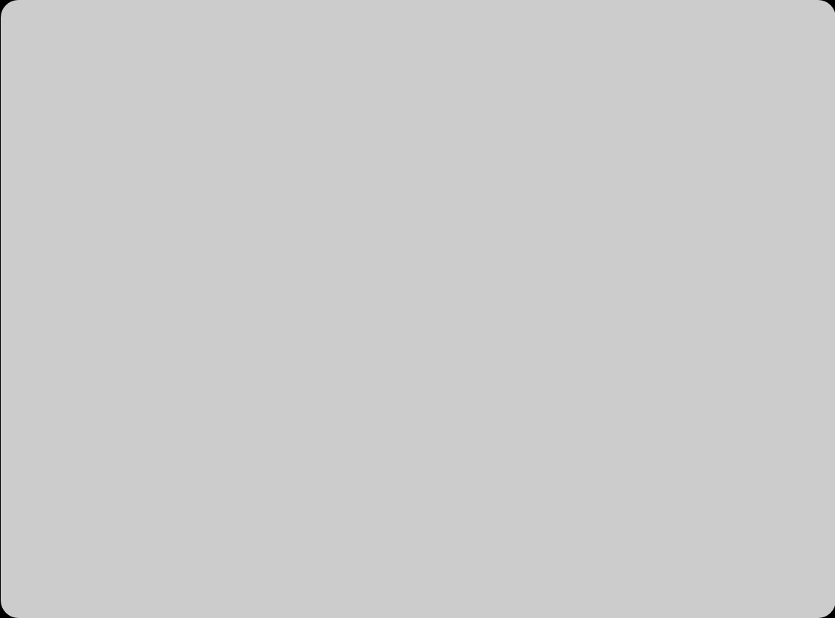
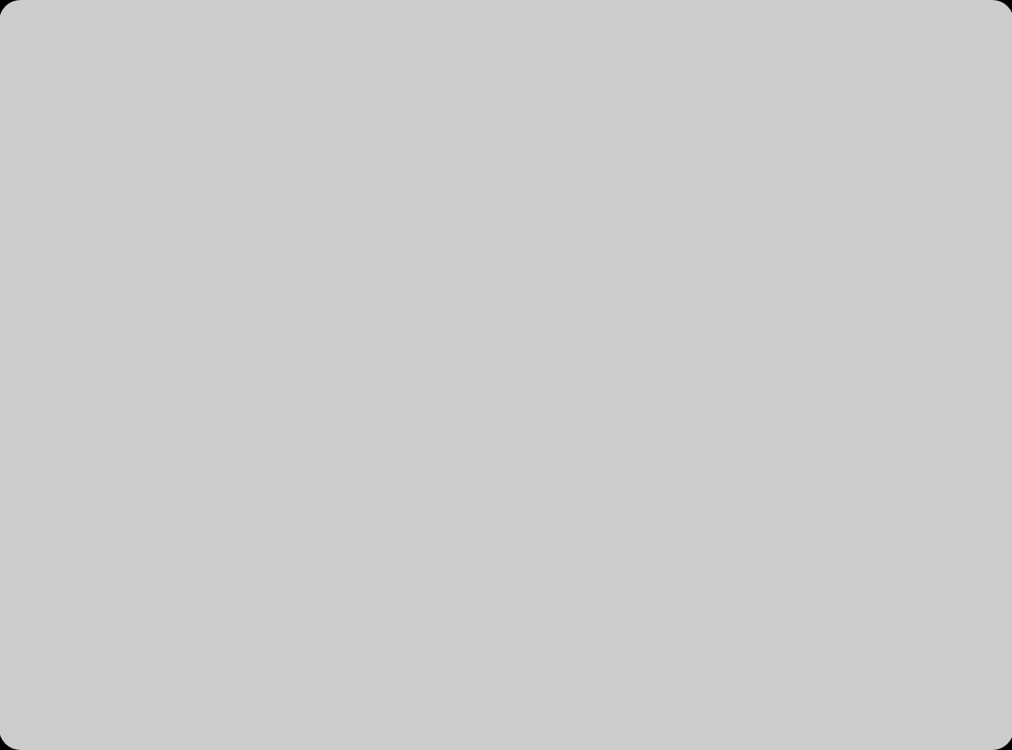








Business Understanding - The Challenge
The mall faces a critical challenge in their current marketing approach that impacts both customer satisfaction and business growth.
Mass Marketing Strategy
Lower Conversion Rates
Unrewarding High-Spenders
Identical offers sent to all customers regardless of behavior
Generic offers fail to resonate with specific customer segments
Loyal high-spenders not recognized or rewarded
One-size-fits-all promotional campaigns
Customers ignore repeated irrelevant promotions
Missing opportunities to increase customer lifetime value
Wastes resources on disinterested customers
Missed opportunities for cross-selling and upselling
Potential for customer churn due to lack of appreciation
This challenge results in decreased revenue, increased marketing costs, and missed growth opportunities.

Slide 4



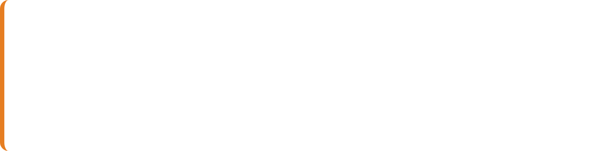
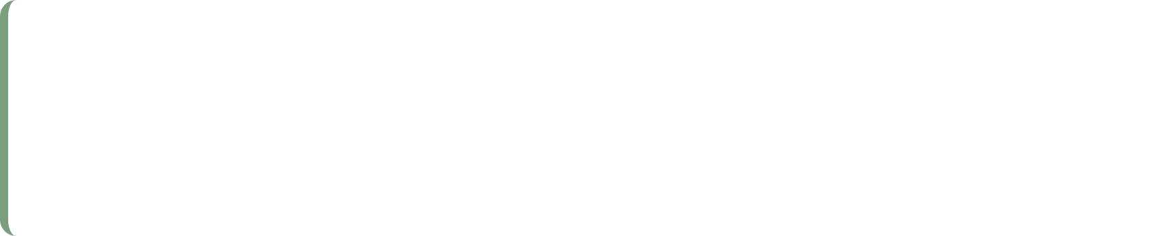




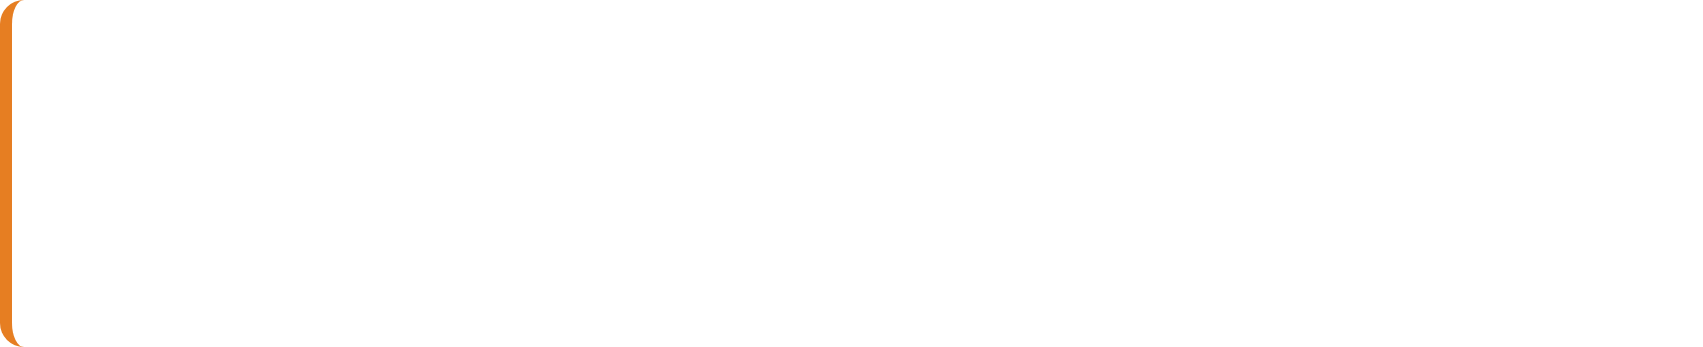











Business Understanding
Objectives & Success Criteria
Objectives
Success Criteria
Identify Customer Groups
Distinct Clusters
Identify distinct customer groups based on behavioral patterns (Spending & Income) rather than just demographics
Produce distinct clusters that allow the marketing team to design specific strategies for each segment
Actionable Personas
Enable Personalization
Create clear customer personas that marketing can easily understand and act upon
Develop targeted marketing strategies tailored to each customer segment's unique characteristics
Measurable Impact
Maximize ROI (Return on Investment)
Demonstrate reduction in churn and increase in revenue through personalization
Optimize the ROI of marketing budget by targeting the right message to the right person
By achieving these objectives and meeting the success criteria, the mall will transform from intuition-based marketing to data-driven targeted strategies

Slide 5



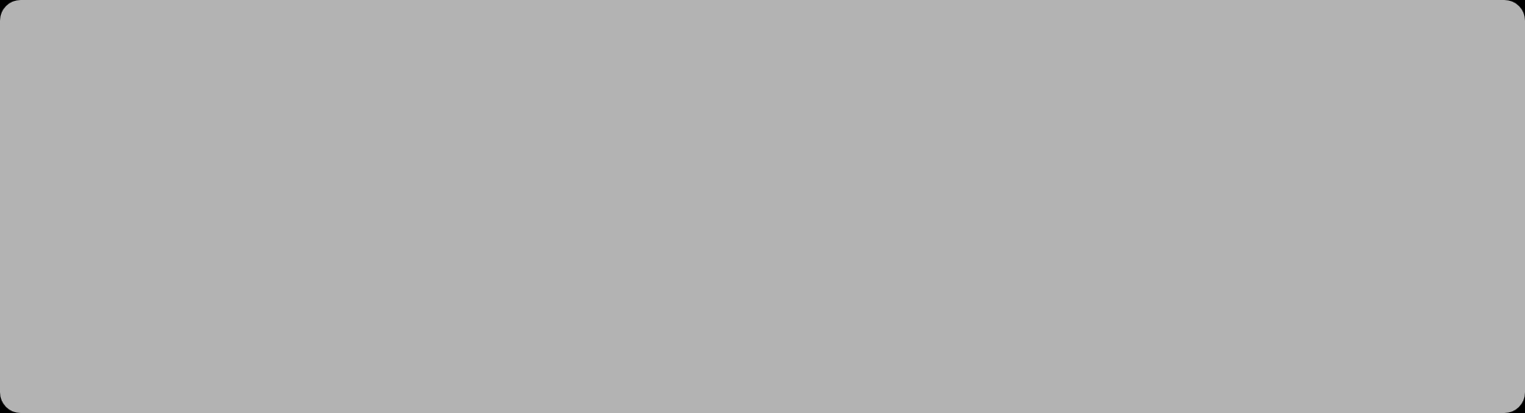




Data Understanding - Dataset Overview
Mall Customers Dataset
Comprehensive dataset containing customer demographics and shopping behavior metrics
Key Behavioral Indicators
Annual Income (k$)
Spending Score (1-100)
Direct measure of customer purchasing power
Proprietary metric based on past behavior
Key determinant of consumption capacity
1 = Low spend, 100 = High spend
Primary indicator of customer value
Measures loyalty and engagement
Why These Features Matter
Our analysis shows that buying behavior is best captured by intersecting Income against Spending Score. This combination provides a view of both ability and willingness to spend, forming the foundation for effective customer segmentation.
mean min max std
CustomerID 100.50 1.0 200.0 57.879185
Age 38.85 18.0 70.0 13.969007
Annual Income (k$) 60.56 15.0 137.0 26.264721
Spending Score (1-100) 50.20 1.0 99.0 25.823522
Key Insights from Statistical Summary:
Wide Demographics: Customer age ranges from 18 to 70, indicating a diverse target audience, not just youth or elderly.
Income Variance: Annual Income varies significantly (15k - 137k), suggesting the presence of distinct economic segments (low vs. high earners).
Balanced Scores: The average Spending Score is 50.2, showing a balanced distribution between high and low spenders.

Slide 6


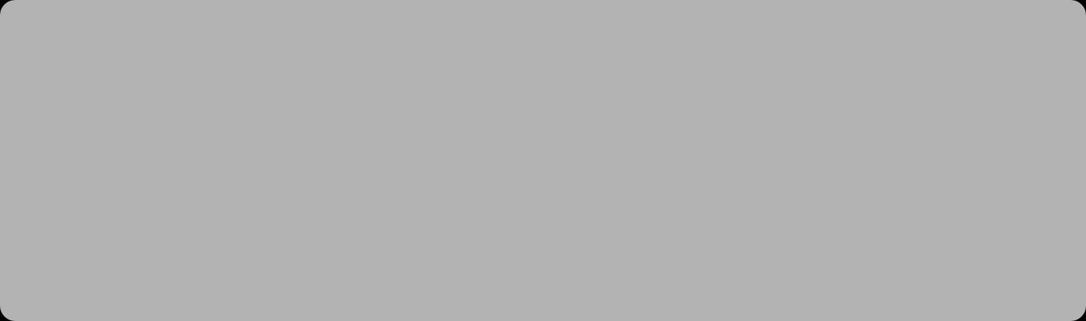
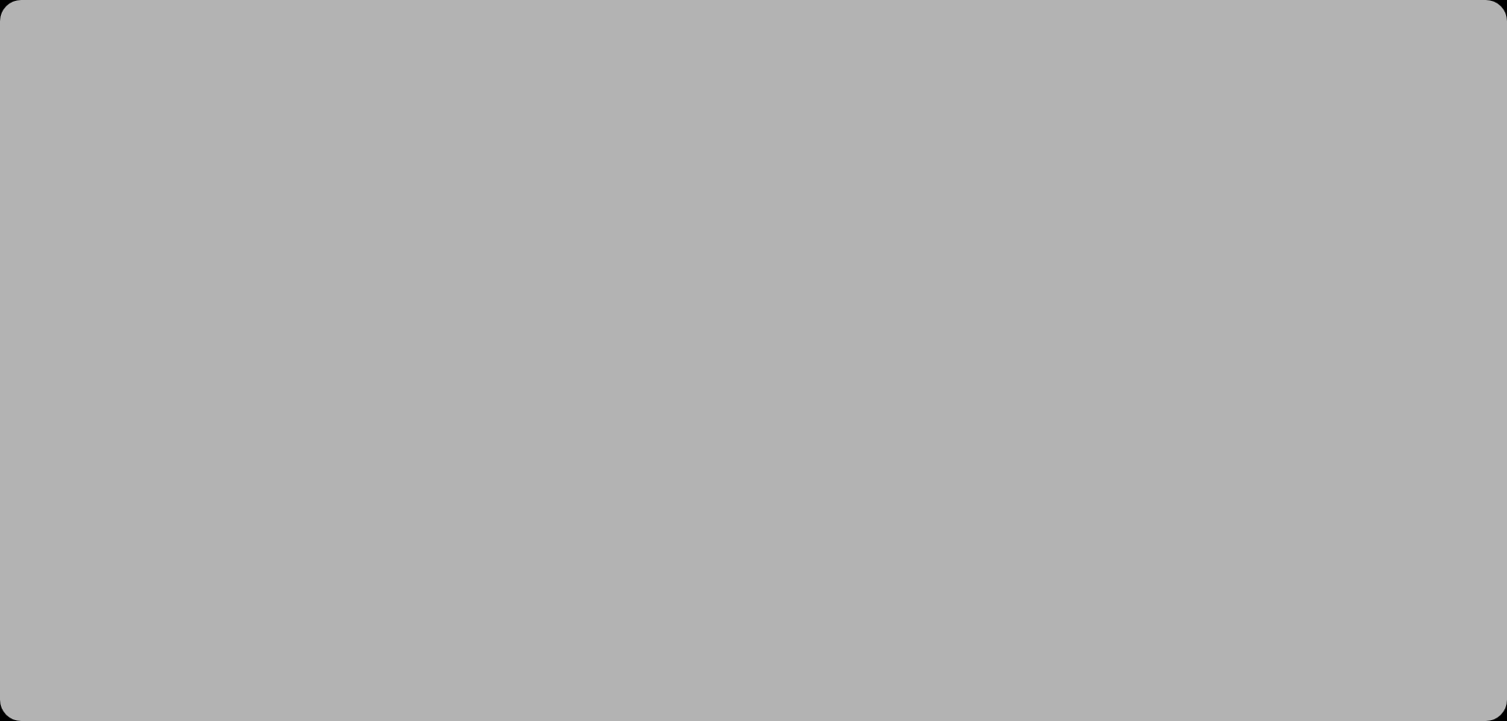











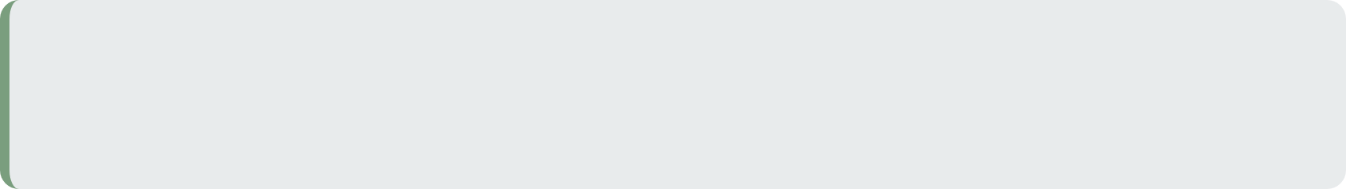







Data Understanding - Feature Selection Rationale
Feature Comparison
Why This Matters
Demographic Features
Key Insights
Age and Gender contain limited predictive power for spending behavior
Our initial exploration showed that buying behavior is best captured by intersecting Income against Spending Score
Inconsistent patterns across age groups
Gender doesn't correlate with purchasing power
Annual Income represents purchasing power
Spending Score (1-100) is a proprietary metric assigning a 'loyalty' score based on past behavior (1 = Low spend, 100 = High spend)
Behavioral Features
Income and Spending Score capture actual purchasing behavior
Direct correlation with purchasing power
Spending Score reflects loyalty and engagement
By focusing on these behavioral features, we can create segments that directly impact the mall's bottom line
Raw Data
Feature Selection
Income vs. Spending Score
Customer Segments

Slide 7
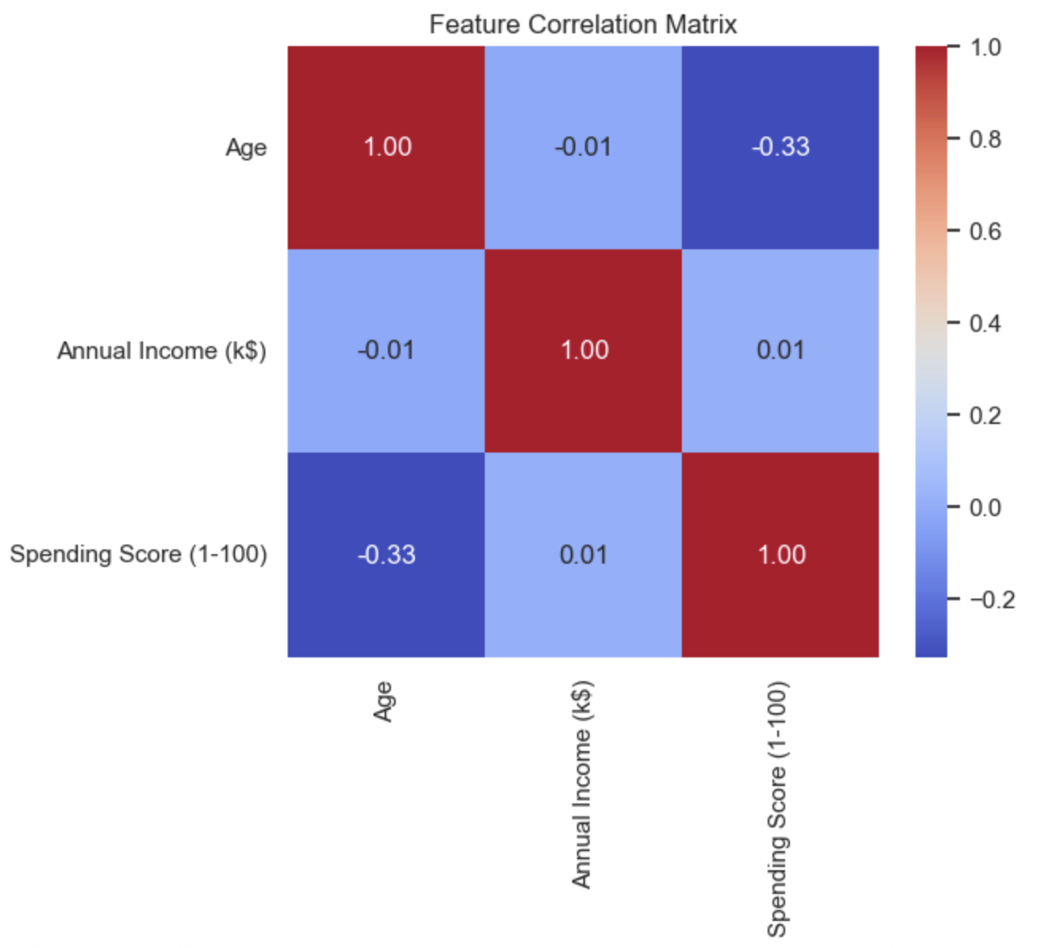
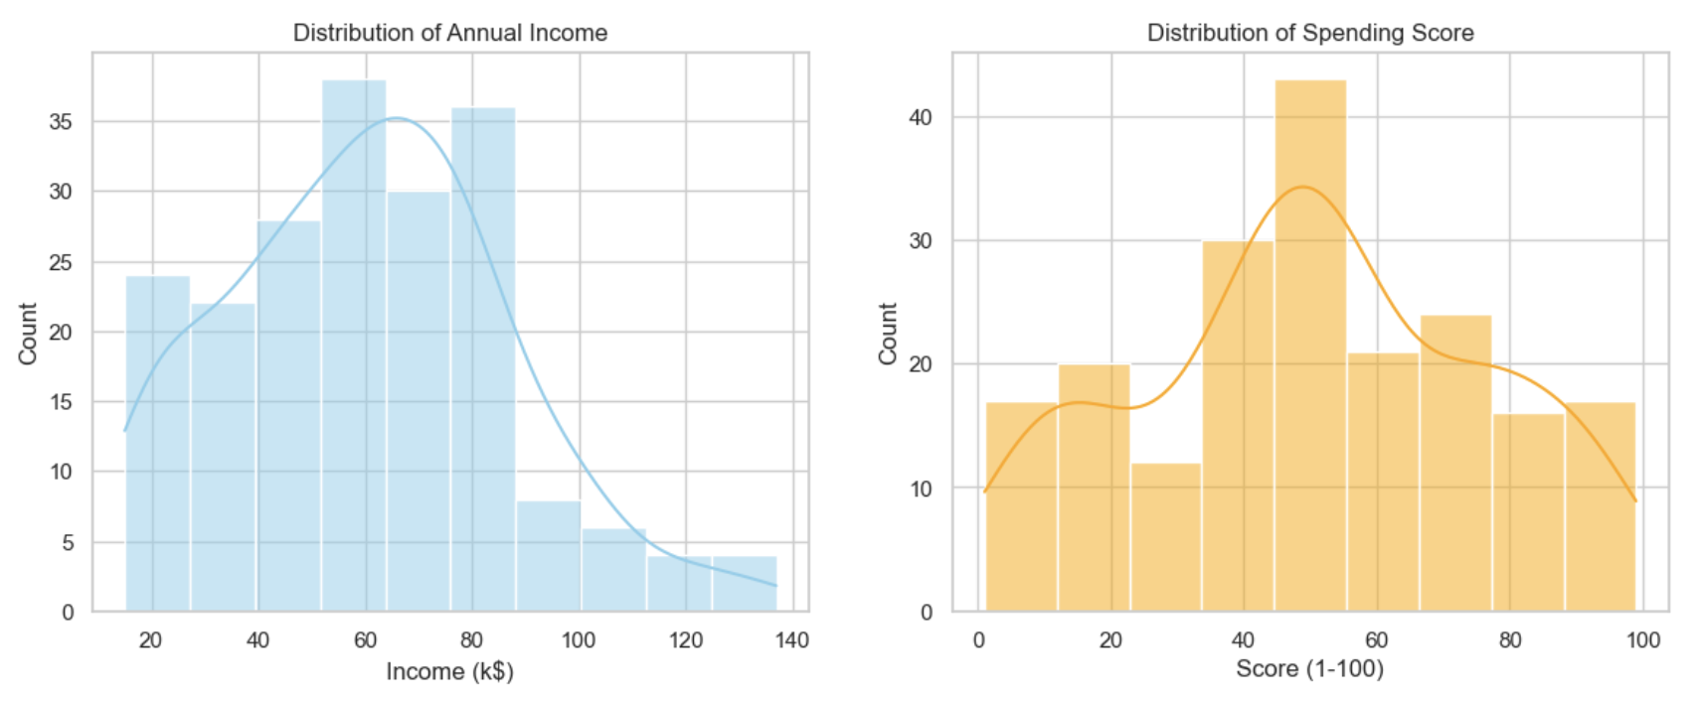
Data Understanding
Correlation Matrix
Distributions
Distribution Analysis:
Income: The distribution is right-skewed, showing few very wealthy individuals (outliers) and a larger mass of middle-income customers.
Score: The spending score follows a somewhat normal distribution but shows multimodality, hinting at natural groups waiting to be segmented.
Correlation Analysis:
Observation: The correlation between Annual Income and Spending Score is near zero (~0.01).
Implication: High income does not guarantee high spending. Since there is no linear relationship, standard regression models fail. This confirms that Clustering (K-Means) is the correct approach to find hidden patterns.

Slide 8
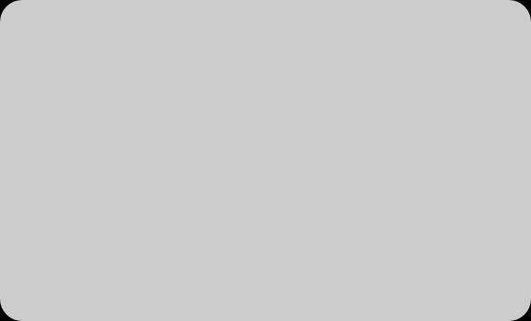









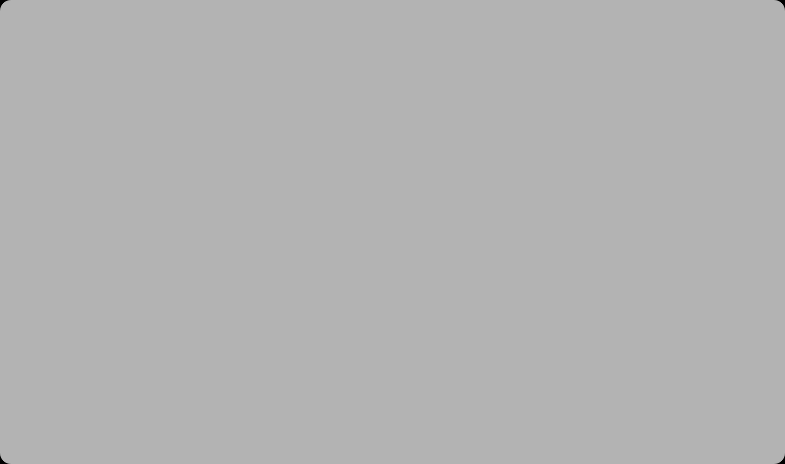
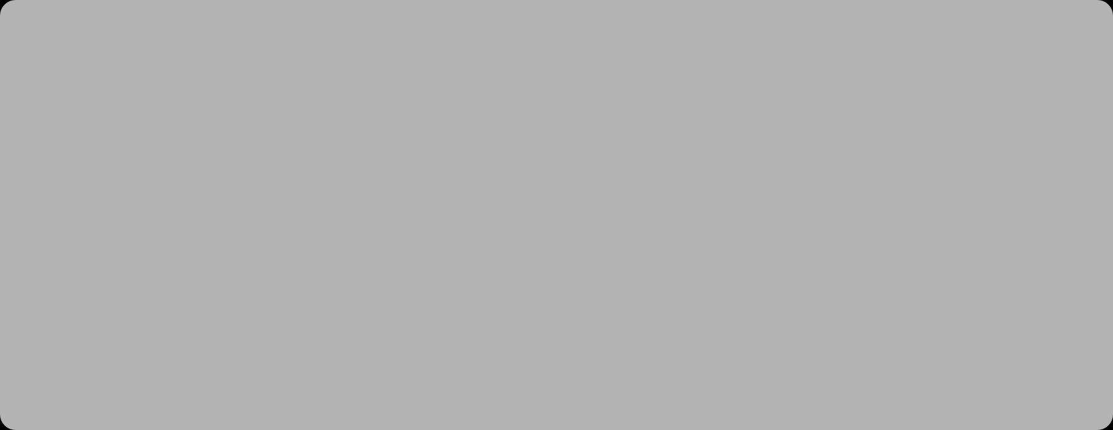








Data Preparation - Preprocessing Pipeline
Ingestion
Feature Selection
Data Cleaning
Feature Matrix
Preprocessing Steps
Code Implementation
Robust Data Ingestion
X = df.iloc[:, [3, 4]].values
Built a robust loader to handle different CSV formats (standard vs. Excel-style) to ensure data integrity
Why This Matters
Behavioral Focus
This creates a feature matrix X containing only Income (Index 3) and Spending Score (Index 4), which is required for the K-Means algorithm to calculate spatial distances effectively
Filtering the dataset to isolate behavioral features, removing demographic noise that doesn't impact segmentation
Feature Matrix Creation
Selected only the most relevant features (Income and Spending Score) to reduce dimensionality and improve model performance
Including irrelevant features like 'Customer ID' would have confused the clustering algorithm and reduced its effectiveness

Slide 9






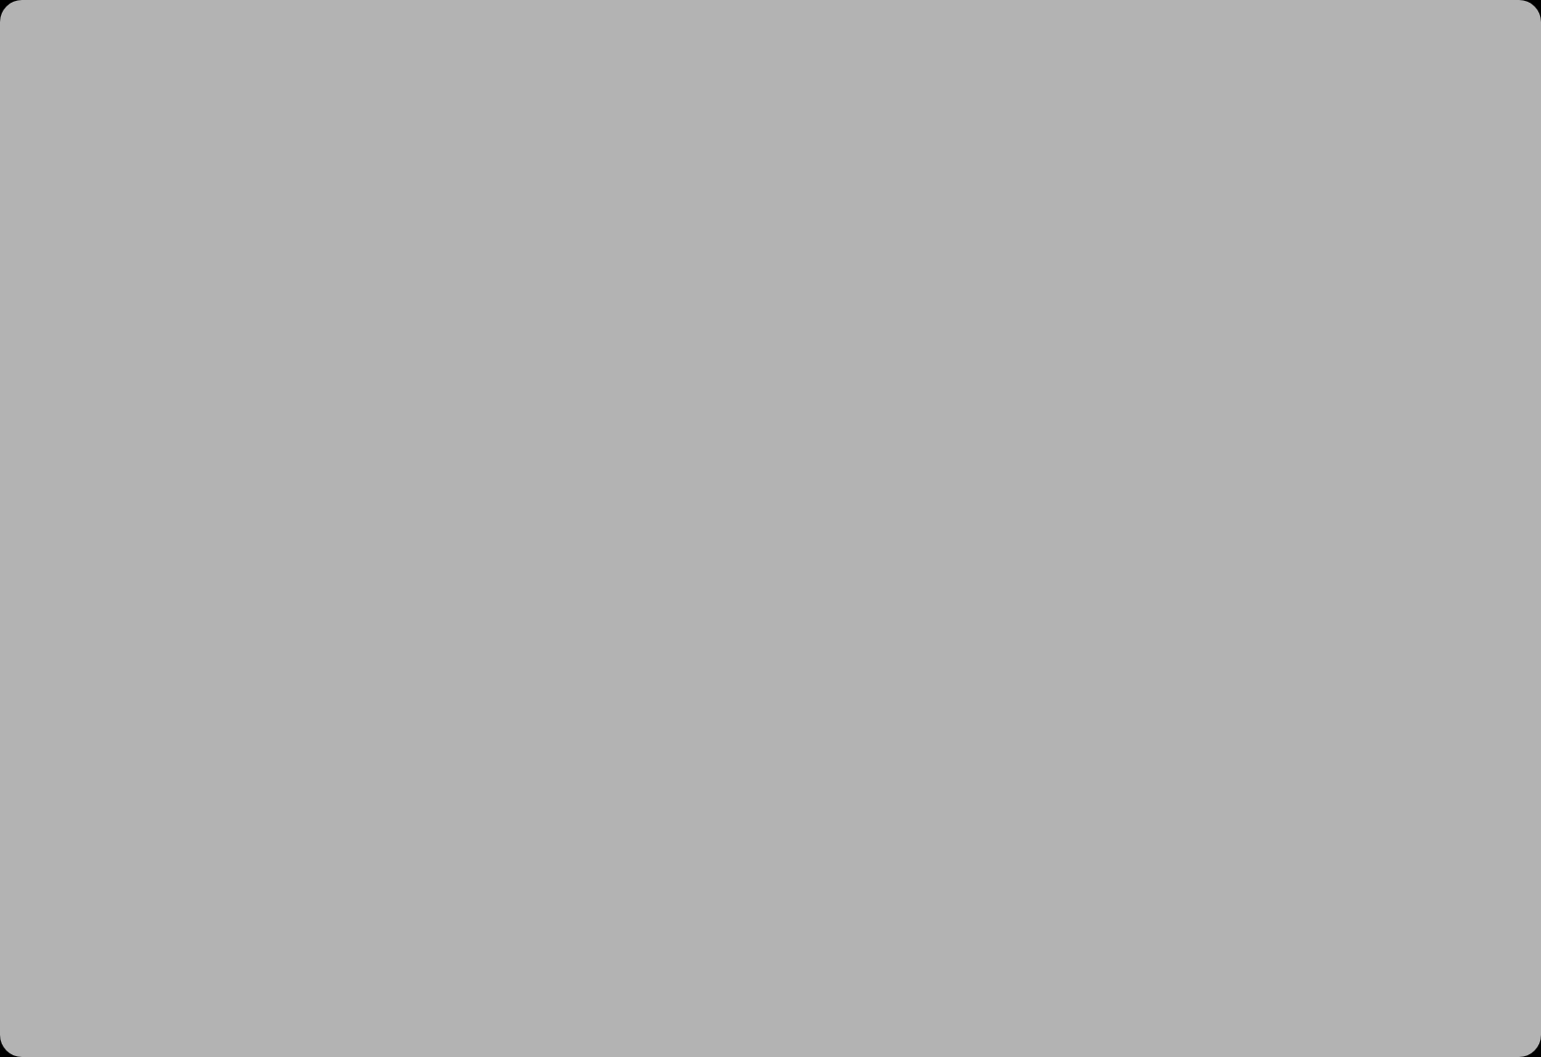















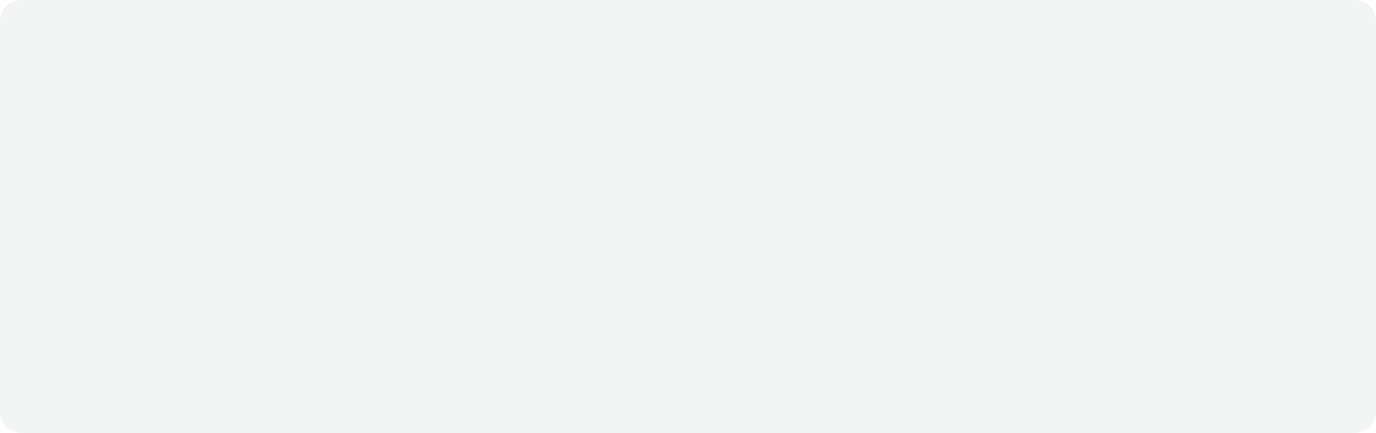
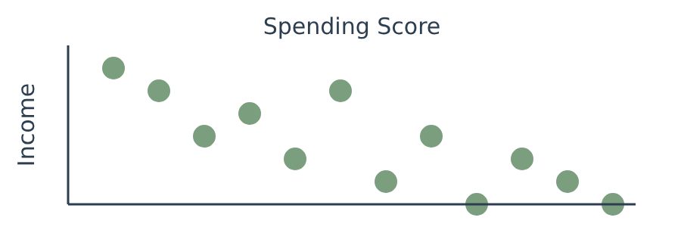
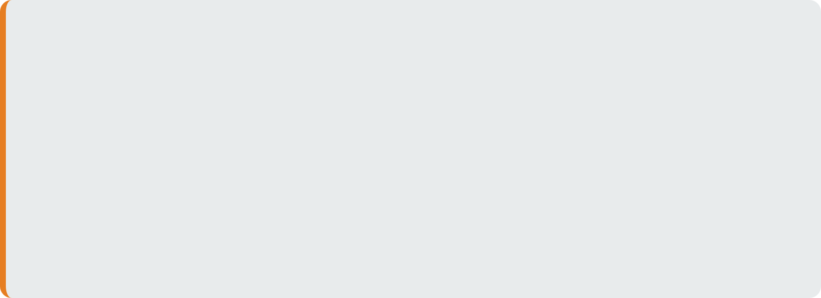

Data Preparation - Feature Engineering
Code Implementation
// Extract relevant features for clustering
const X = df.iloc[:, [3, 4]].values;
Feature Selection Process
Purposeful Filtering
We purposely filtered the dataset to isolate behavioral features, removing noise from demographic data
Data Transformation
Column Selection
Before
Selected only the columns that directly relate to customer spending behavior
After
Raw Dataset
Feature Matrix X
Feature Matrix Creation
Customer ID
Age
Gender
Income
Score
Income
Score
Created matrix X containing only Income and Spending Score for K-Means clustering
K-Means Algorithm Input
Transformation: Feature Scaling (Crucial Step)
Why: The 'Annual Income' feature (Range: 15k-137k) dominates the 'Spending Score' (Range: 1-100) due to larger magnitude.
Action: Applied StandardScaler to normalize both features to a mean of 0 and variance of 1.
Result: Ensures that the K-Means algorithm treats both Income and Spending Score with equal importance when calculating Euclidean distances.

Slide 10
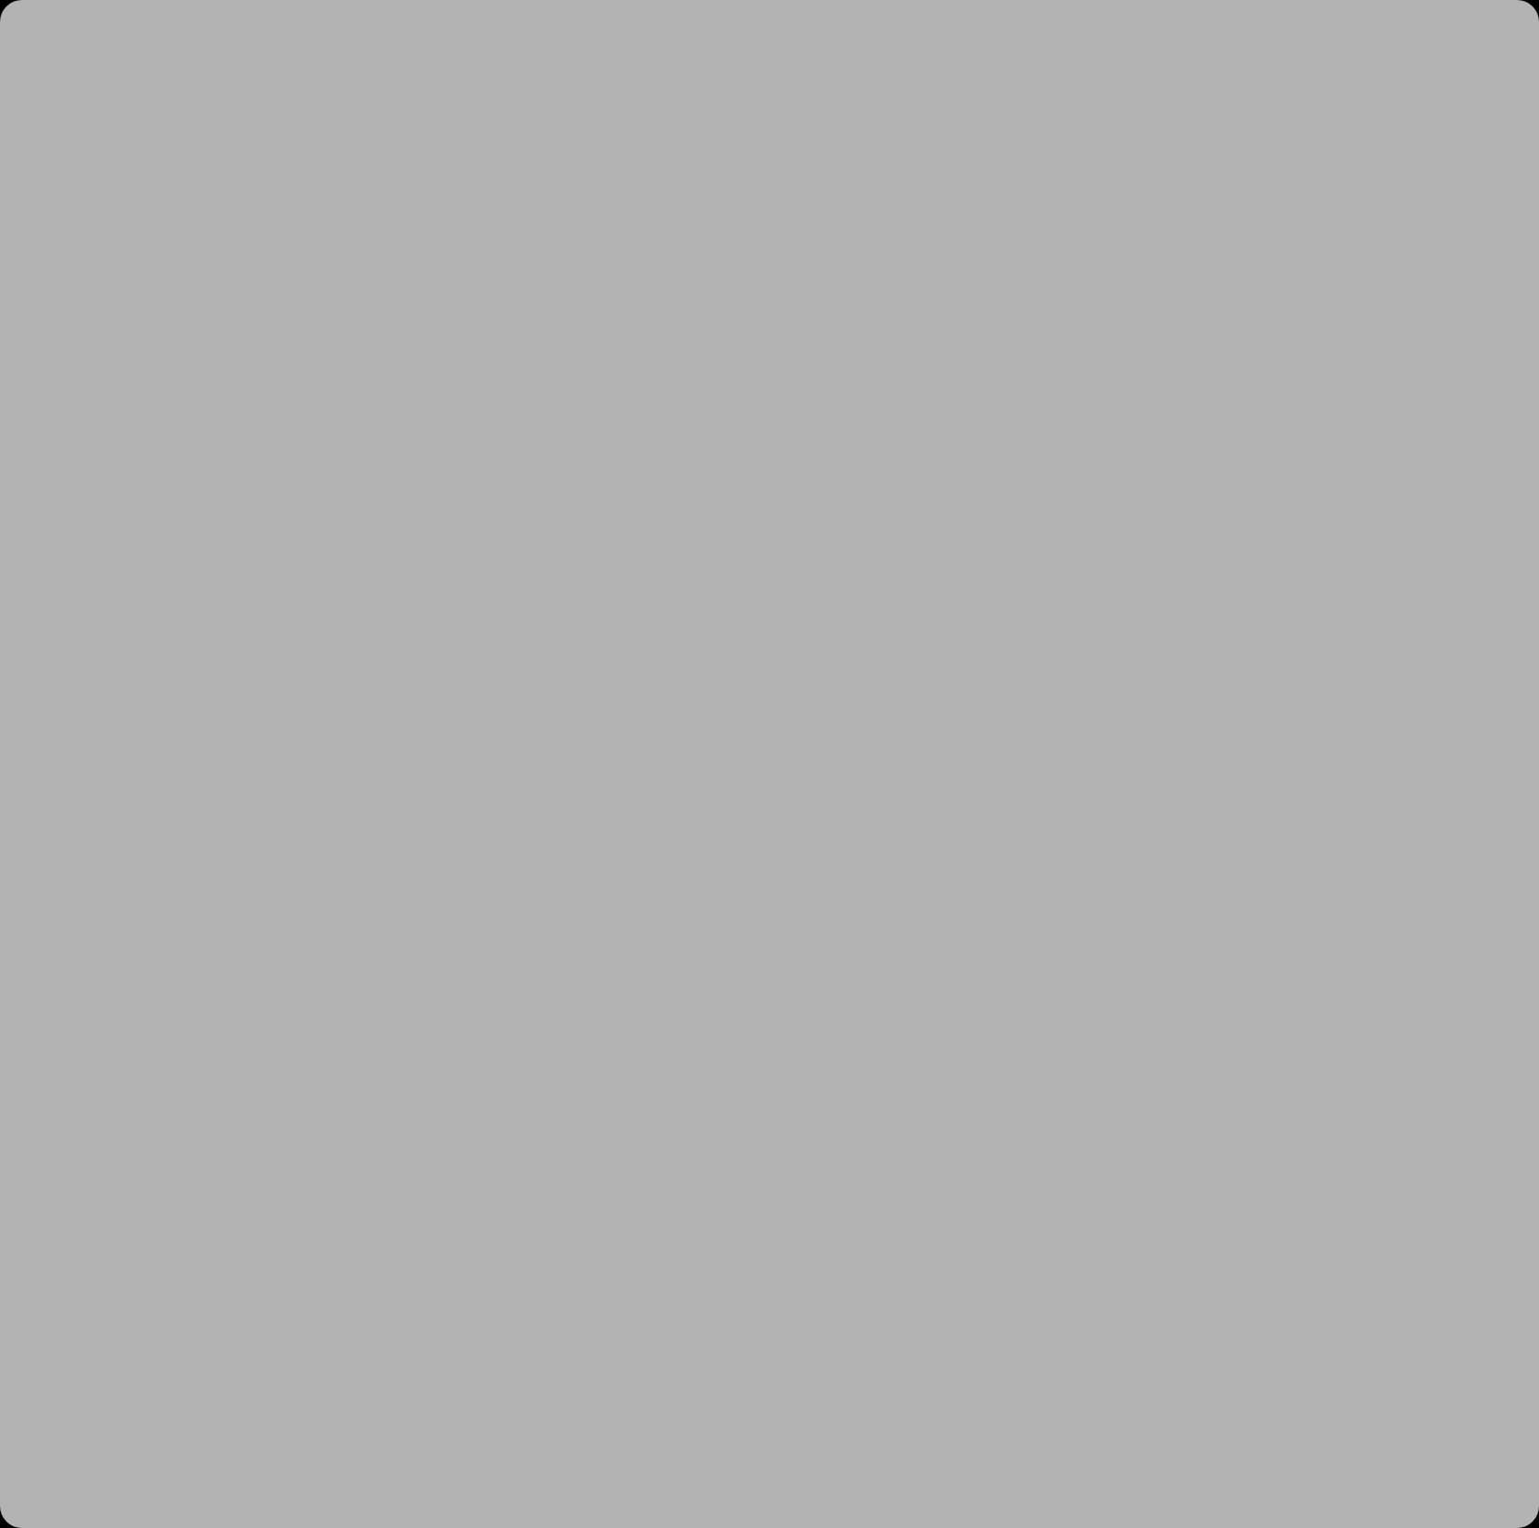
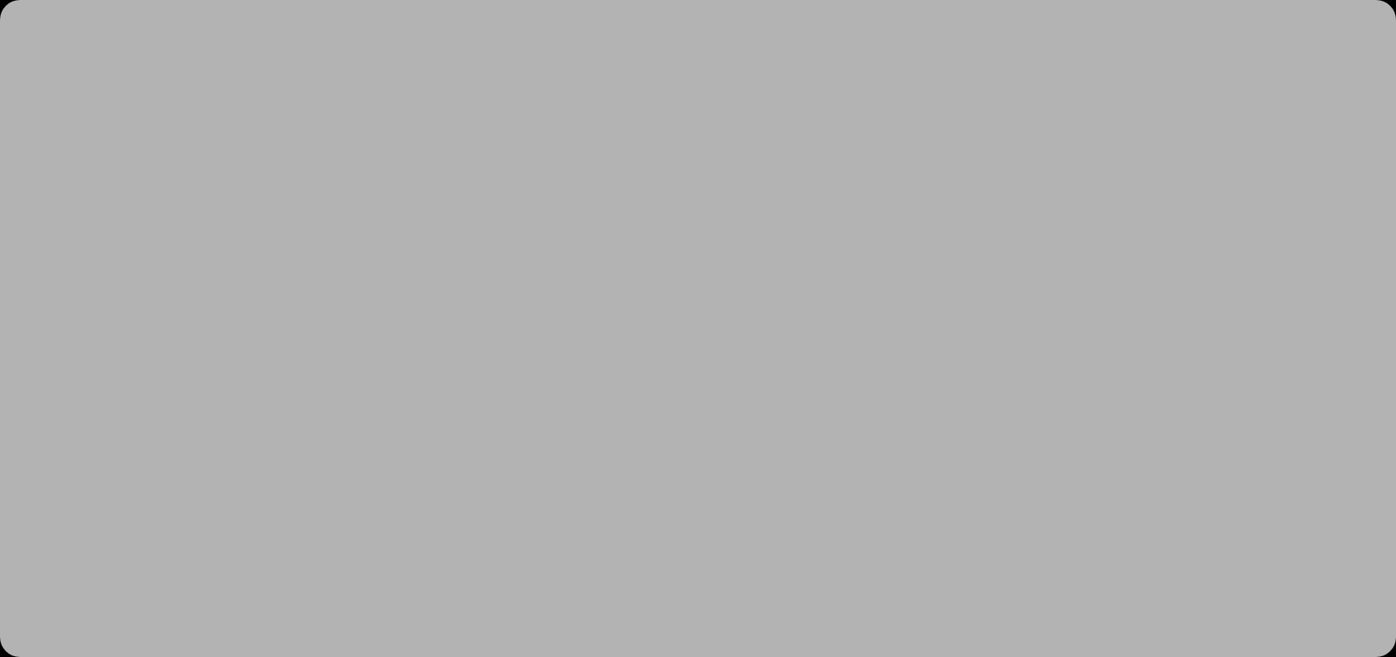









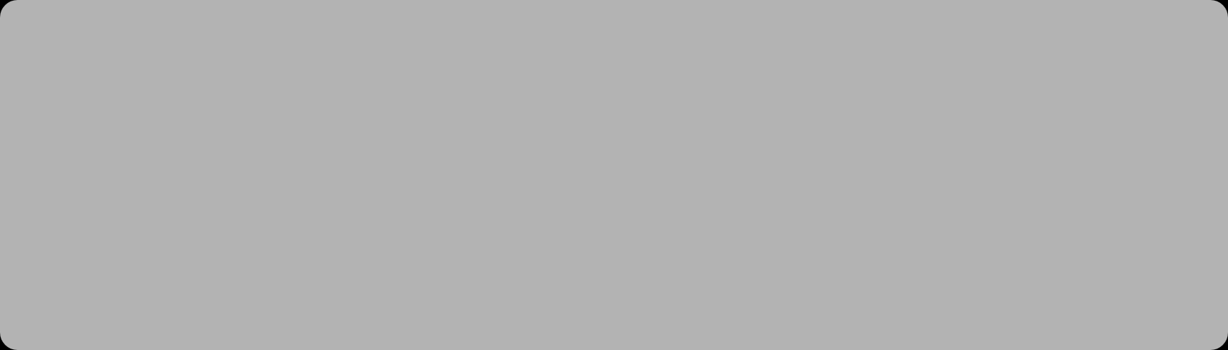

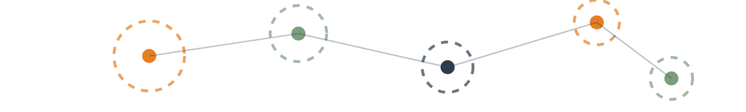
Modeling - Algorithm Selection
Algorithm Selection
Why K-Means?
K-Means Clustering
n_clusters=5
Computational Efficiency
Cluster Identification
Based on data analysis
For customer segmentation
Fast with large datasets
Identifies spherical clusters
init='k-means++'
random_state=42
Optimizes centroid placement
Continuous Data
Distinct Grouping
Ensures reproducible results
For spending & income analysis
Creates customer segments
Criteria | Rationale for Choosing K-Means
1. Interpretability | Business-Friendly: It provides clear, non-overlapping boundaries (e.g., "High Income vs. Low Score"), making it easy to explain to the marketing team.
2. Scalability | High Performance: Unlike Hierarchical Clustering, K-Means is computationally efficient and scales well as our customer database grows.
3. Full Coverage | No "Unclustered" Customers: Unlike DBSCAN, which treats outliers as "noise" (discarding them), K-Means assigns every customer to a segment, ensuring no marketing opportunity is lost.
4. Strategic Control | Flexible K-Value: It allows us to determine the optimal number of campaigns (K=5) based on both the Elbow Method and business capacity, rather than letting the algorithm decide arbitrarily.
K-Means Clustering Concept

Slide 11

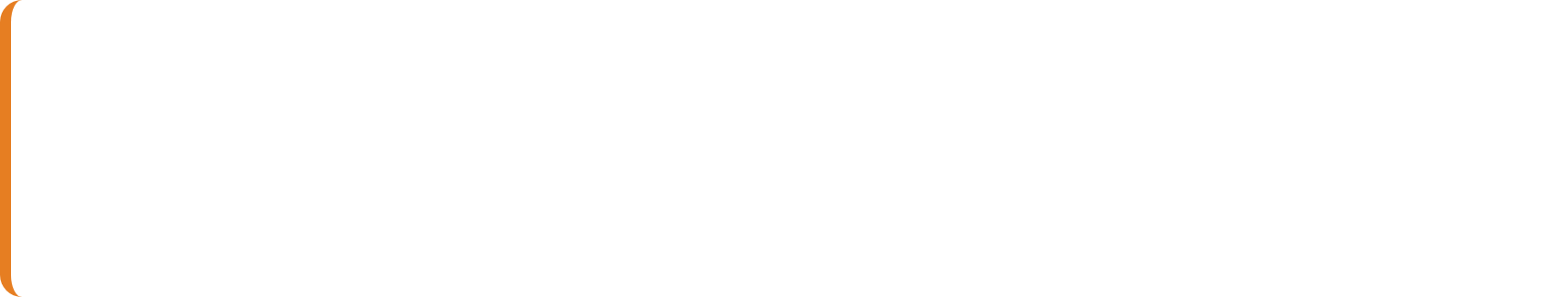
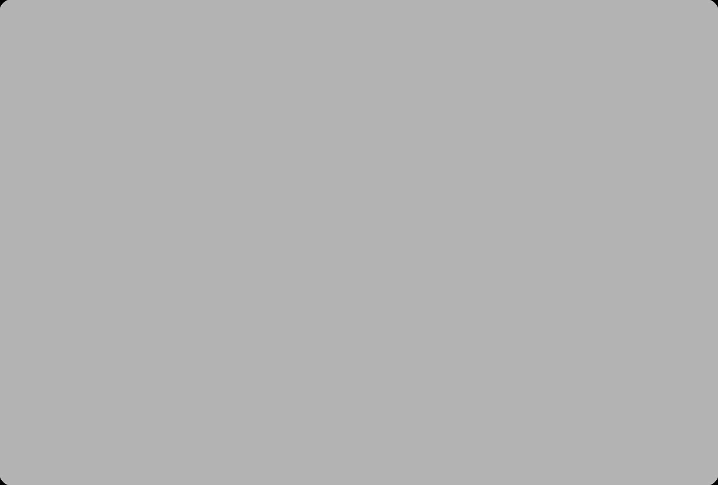
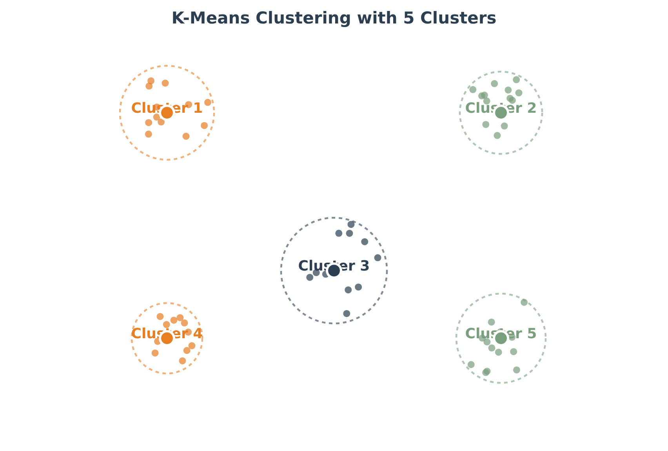


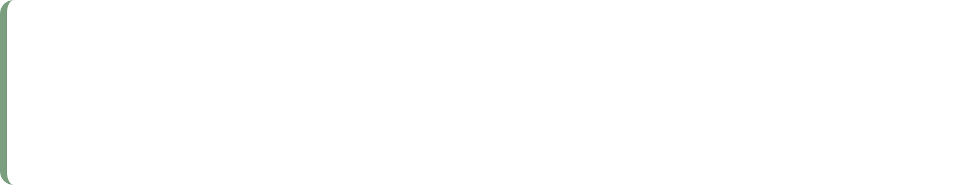
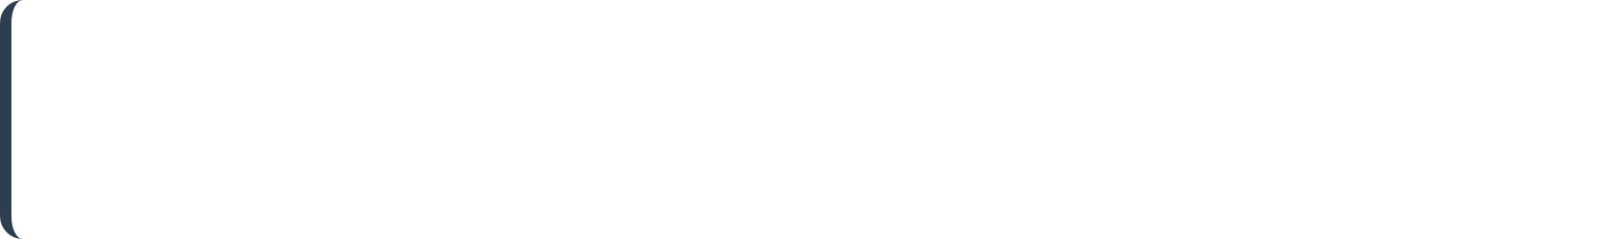



Modeling - Configuration & Hyperparameters
Model Configuration
K-Means Clustering Process
n_clusters=5
Determined by analyzing the data distribution (Elbow Method implies 5 distinct groups)
init='k-means++'
Optimizes the initial centroid placement for faster convergence
random_state=42
Ensures results are reproducible across different runs
Configuration Code: kmeans = KMeans(n_clusters=5, init='k-means++, random_state=42)

Slide 12


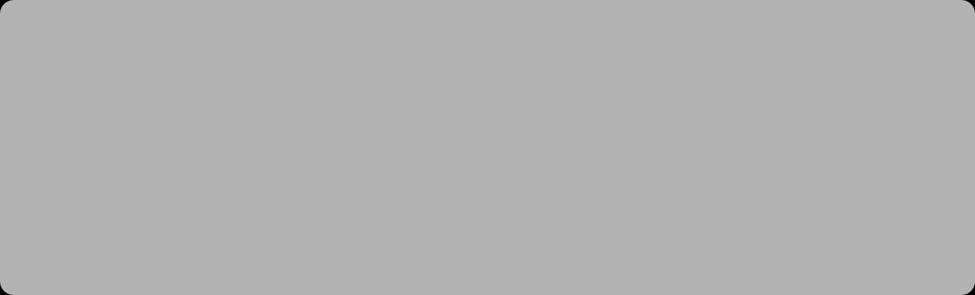
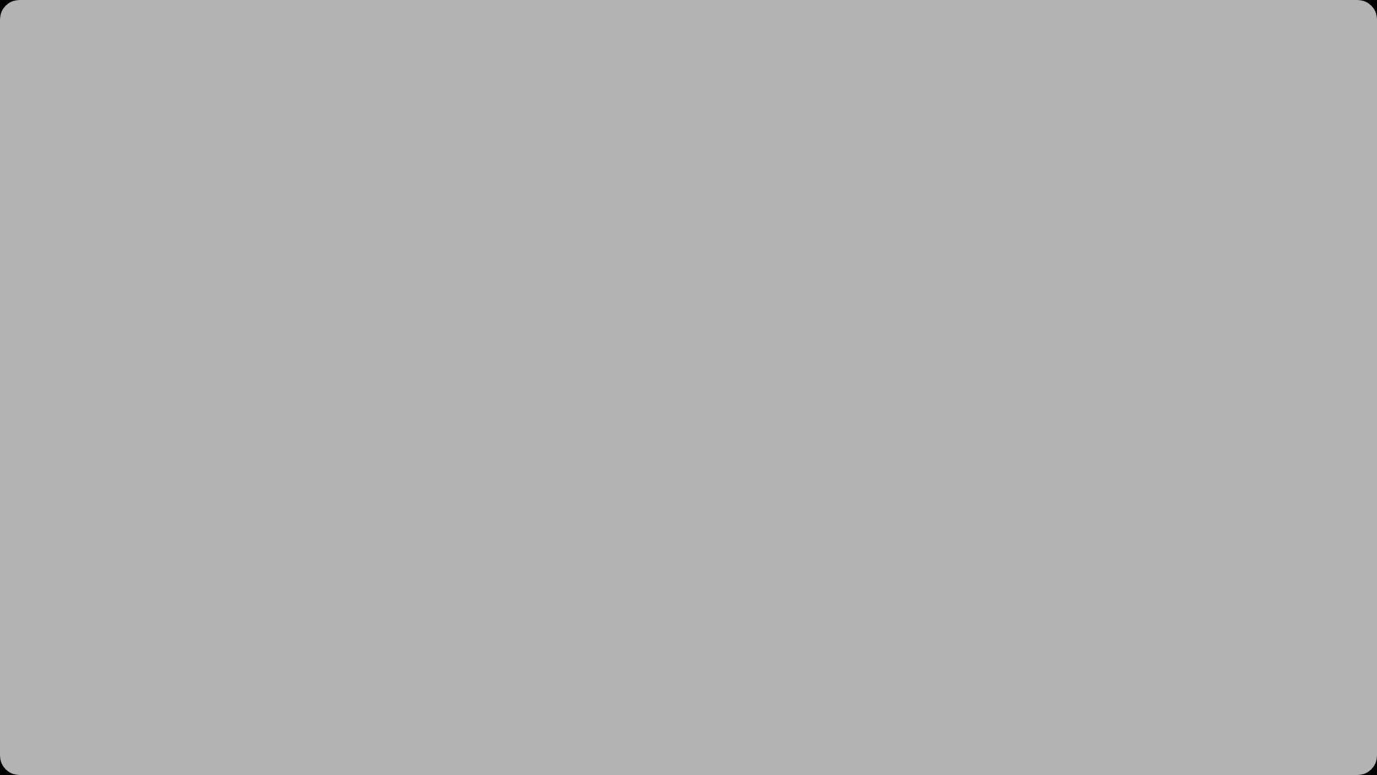

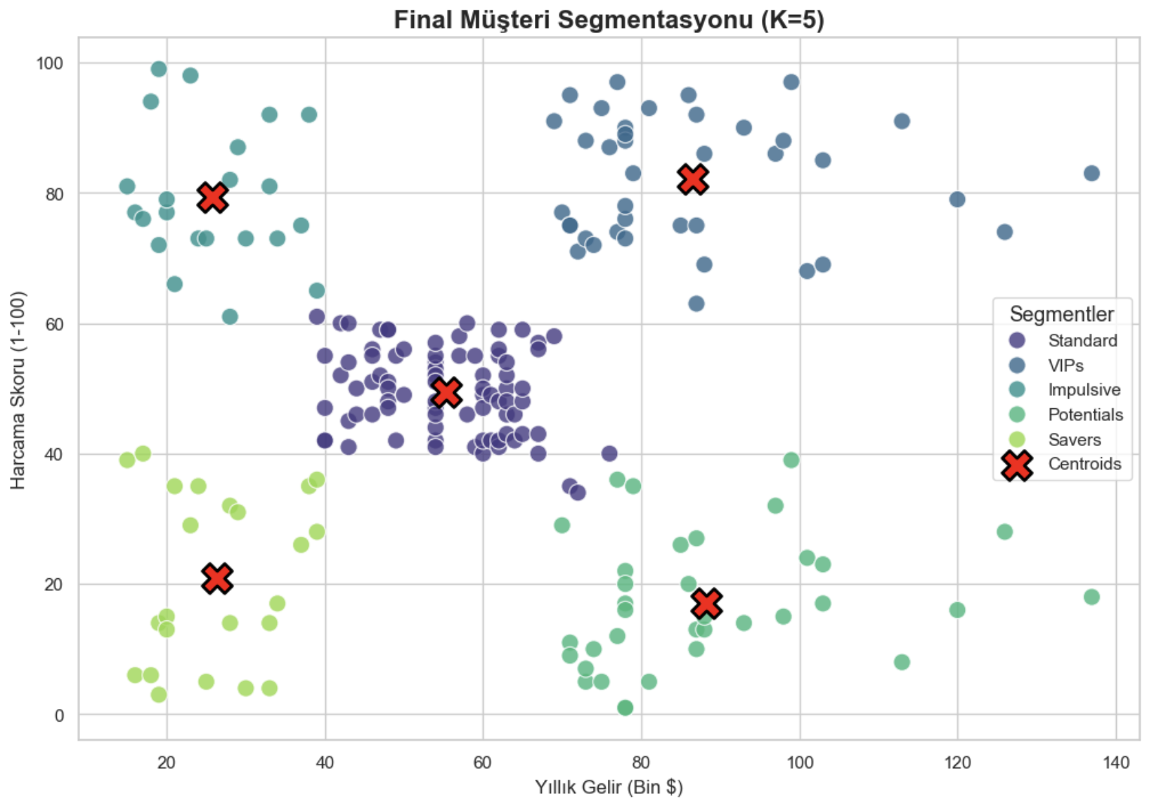




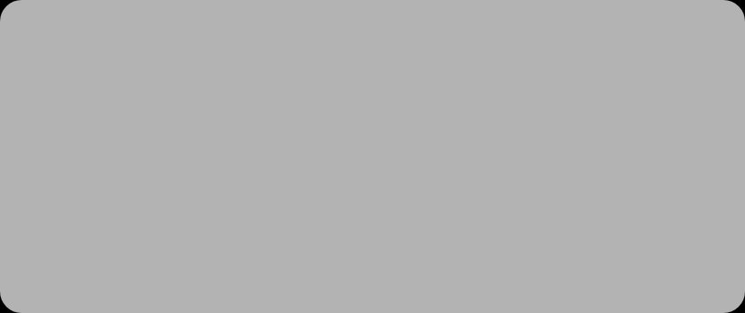




Modeling - Implementation & Execution
Implementation
Execution Visualization
K-Means Configuration
Configured to find 5 distinct groups (n_clusters=5) with optimized centroid placement (init='k-means++')
Random State
Set random_state=42 to ensure reproducible results
Code Implementation
$ kmeans = KMeans(n_clusters=5, init='k-means++', random_state=42)
$ kmeans.fit(X)
$ y_kmeans = kmeans.fit_predict(X)
Centroids
Cluster Assignment
Mathematical "average customers" for each segment
Each customer assigned to their closest centroid
The fit_predict method learns the geometric centers (centroids) of the groups and assigns every customer to one of the 5 segments.

Slide 13


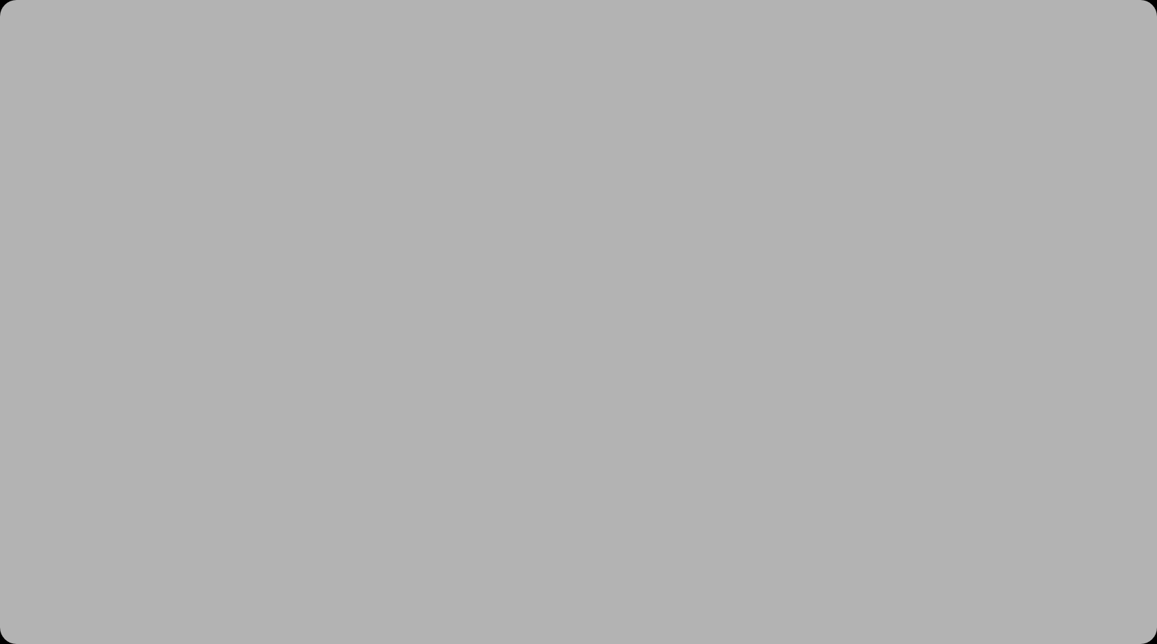
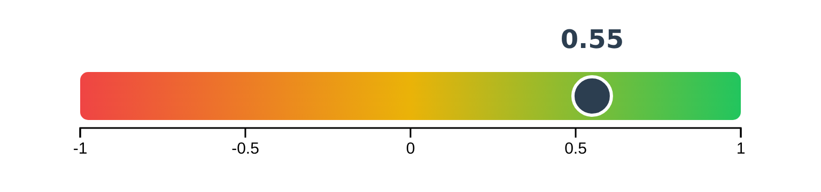













Evaluation - Technical Validation
Silhouette Score
Score Interpretation
0.55
Metric: Silhouette Score ranges from -1 to +1
Interpretation: A score of 0.55 indicates reasonably well-separated and cohesive clusters
The model has successfully distinguished between different customer behaviors
Poor Clusters
Average Clusters
Good Clusters
Score → -1
Score → +1
Score → 0
Technical validation confirms our clustering model is effective at identifying distinct customer segments based on spending behavior.
A score of 0.55 demonstrates that our clusters are well-defined and have meaningful distinctions between them.
Technical Success
Our K-Means clustering model with 5 clusters successfully identifies distinct customer segments with a Silhouette Score of 0.55, confirming the mathematical validity of our approach.
12/20

Slide 14
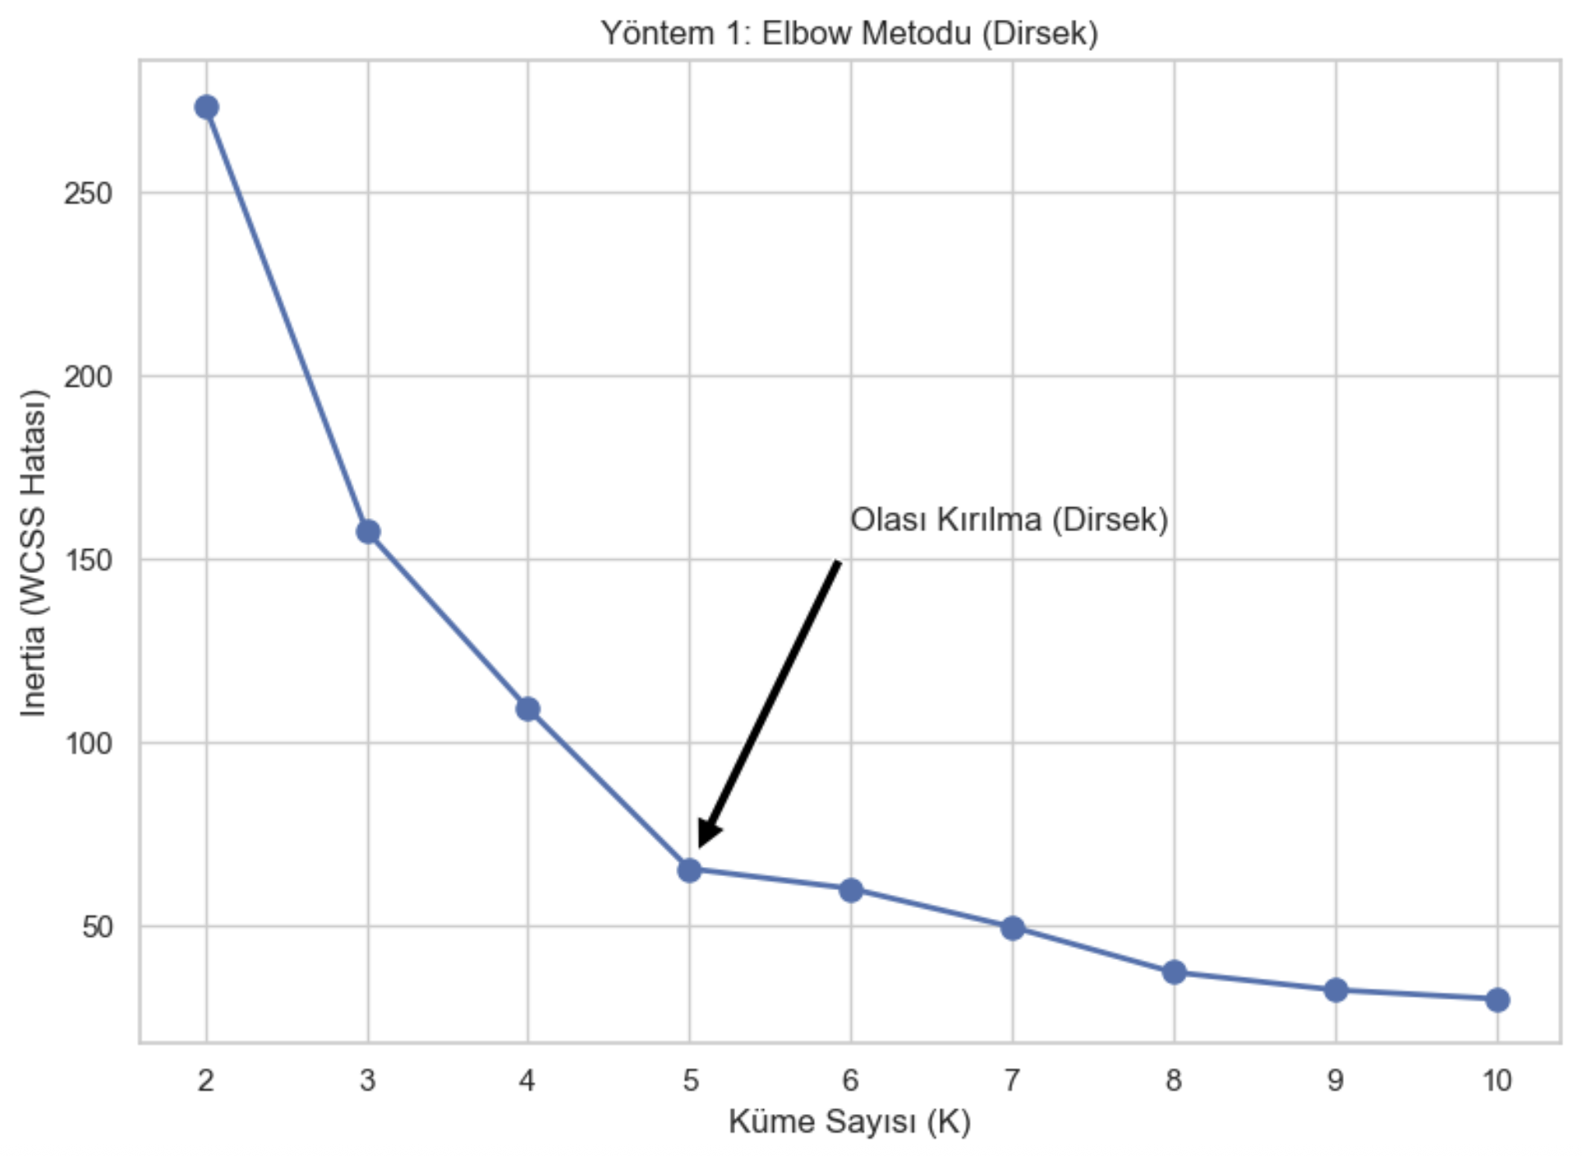
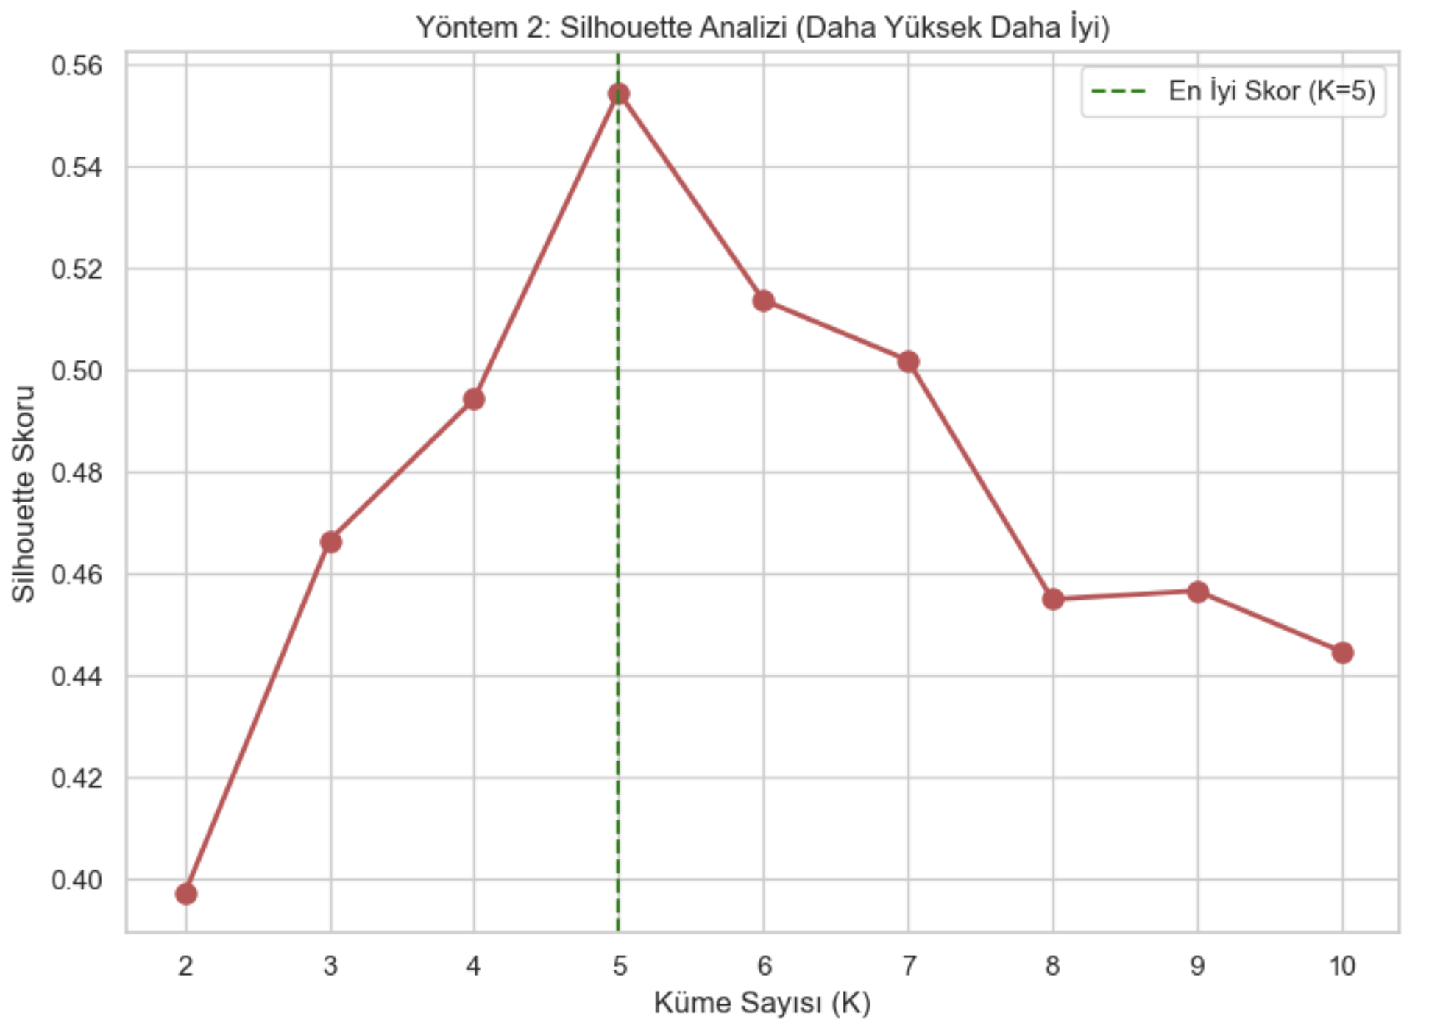
Evaluation - Technical Validation
Elbow Method
Silhouette Score
12/20

Slide 15
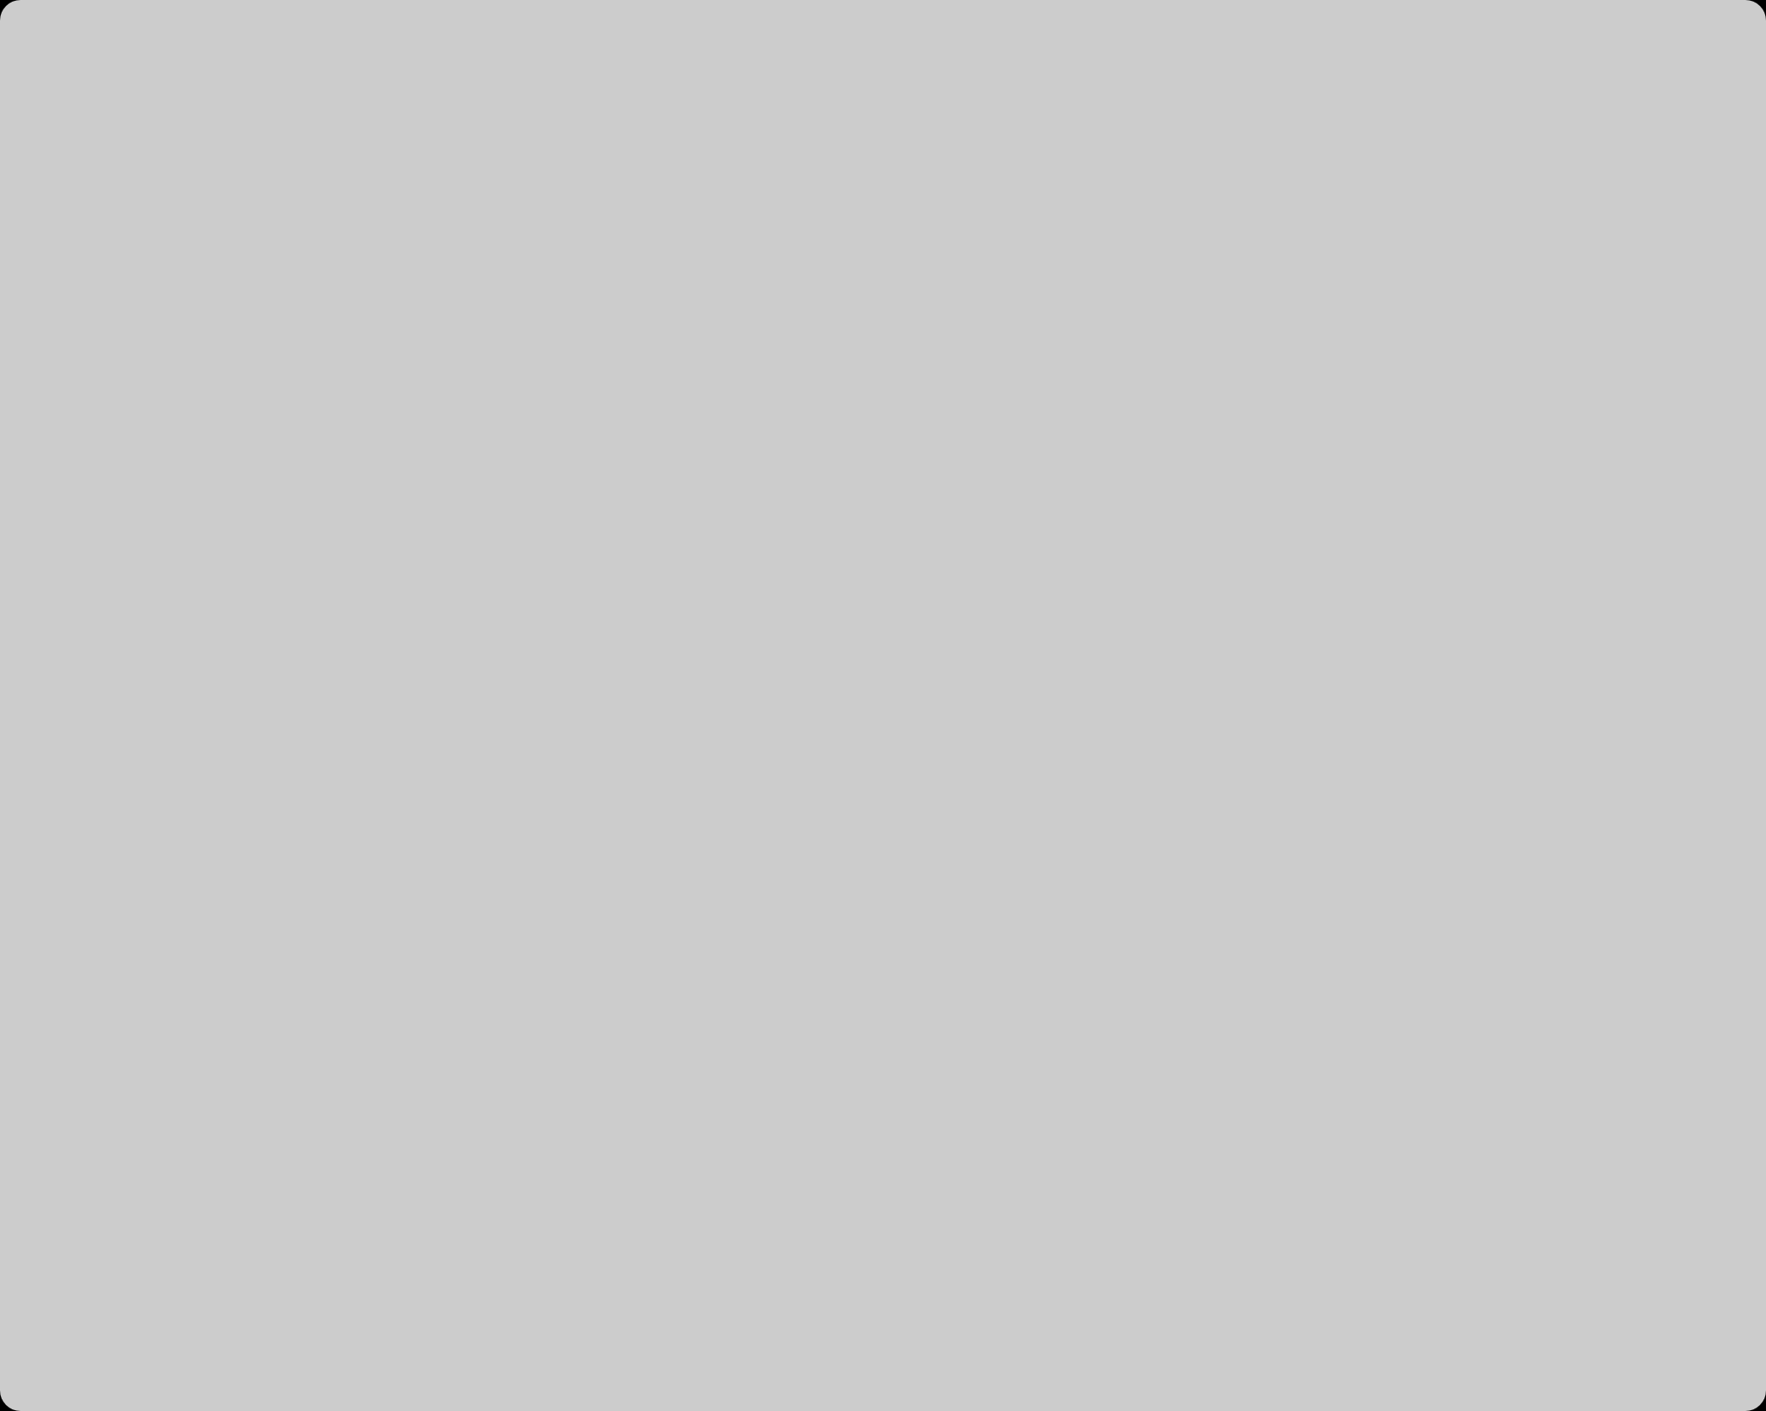

Evaluation - Visual Validation
Cluster Visualization
Key Observations
Cluster Distinct Segmentation: The scatter plot reveals 5 clearly separated clusters with minimal overlap, validating the K=5 model selection.
Dynamics:
  Target Group (Top-Right): Customers with high income and high spending scores are clearly isolated.
  Mass Market (Center): The dense cluster in the middle represents the 'Average' consumer.
Centroids (Red Markers): The red markers indicate the mathematical center of each cluster, representing the "typical persona" for that segment.

Slide 16
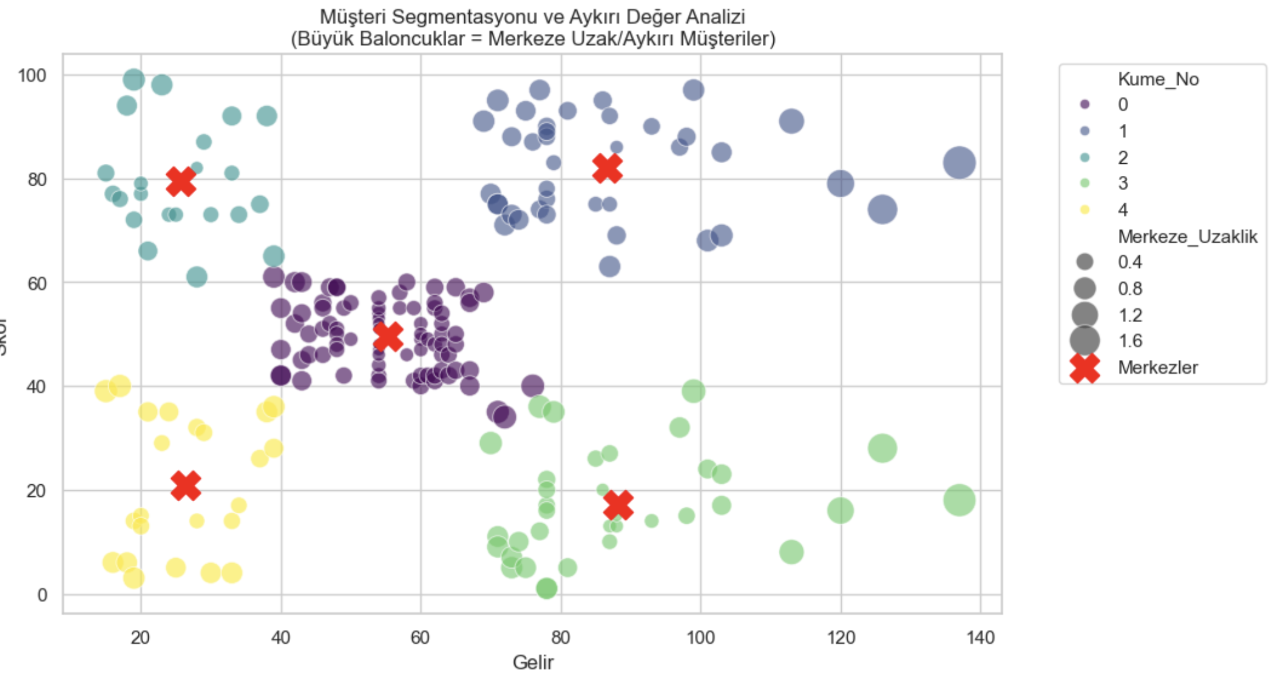
Evaluation – Anomaly Detection
Anomaly Visualization
Key Observations
Methodology (Visual Encoding): We visualized cluster cohesion using Euclidean Distance. The size of each bubble is directly proportional to how far that customer is from their segment’s "ideal" center.
Detection: Larger bubbles indicate 'Edge Cases' or anomalies. These are customers who technically belong to a segment but exhibit unique or extreme behaviors compared to the group average.
Insight: While small dots represent highly consistent customers (strong fit), the large bubbles highlight "non-standard" behavior. Identifying them ensures our core strategies target the majority, while preventing outliers from skewing the results.

Slide 17
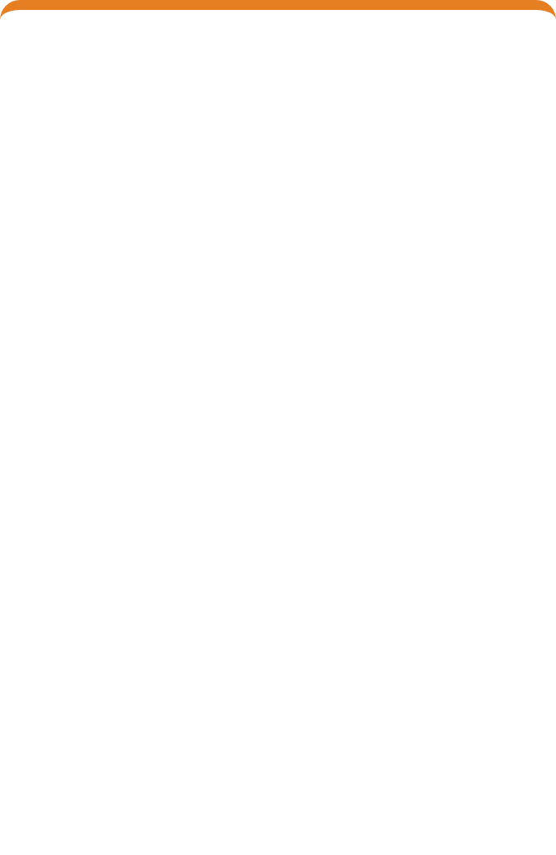
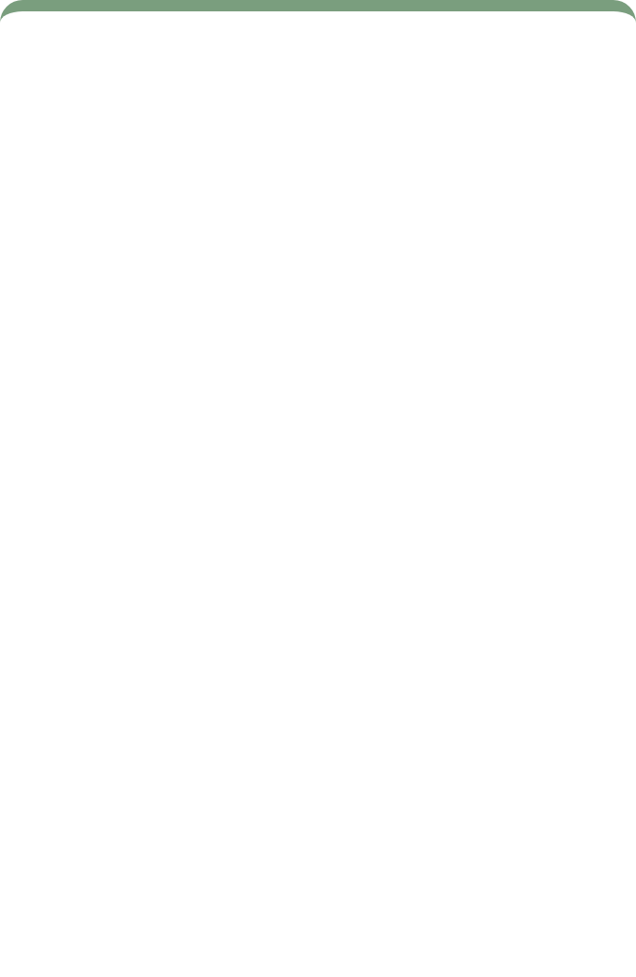
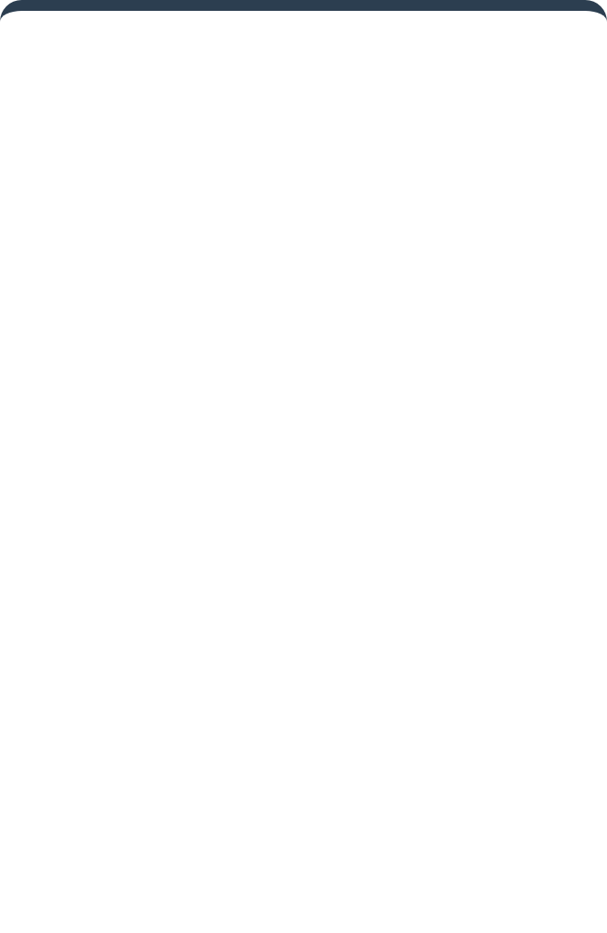













Business Insights - Customer Personas
We identified five distinct customer segments with unique spending behaviors and characteristics
VIPs
Potentials
Standard
Impulsive
Savers
(High Income, High Spend)
(High Income, Low Spend)
(Mid Income, Mid Spend)
(Low Income, High Spend)
(Low Income, Low Spend)
Most valuable group
High purchasing power
Reliable average customer
Young or credit-driven
Cautious spenders
High purchasing power
Low engagement
Heavy spending despite income
Stick to essentials
Loyal and consistent spenders
"Missed opportunity" group
Forms bulk of mall traffic
Price and value conscious
Emotionally driven purchases
Price sensitive but regular
Key Insight: These personas represent distinct customer segments with unique value propositions and marketing needs

Slide 18
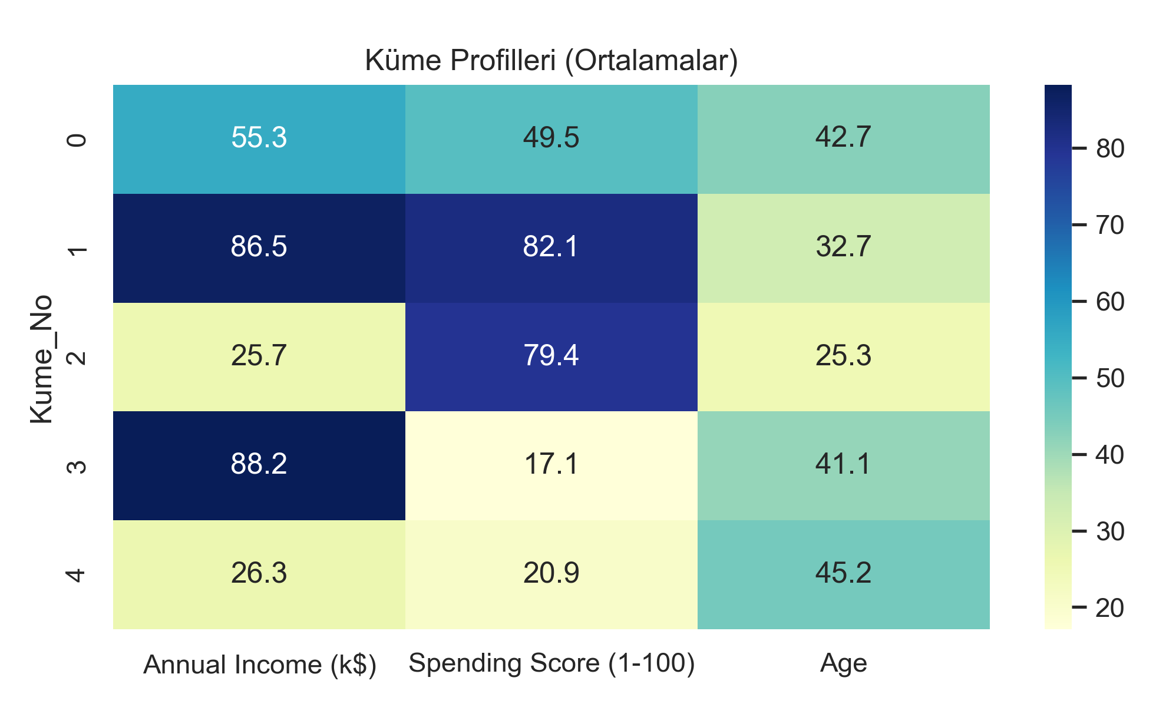
Business Insights - Customer Personas Heat Map Analysis
VIPs - [High Income, High Score]
Average Age: ~32
Annual Income: $86,000 (Highest)
Spending Score: 82/100
Potentials - [High Income, Low Score]
Average Age: ~41
Annual Income: $88,000
Spending Score: 17/100
Impulsive - [Low Income, High Score]
Average Age: ~25 (Youngest)
Annual Income: $25,000
Spending Score: 79/100
Savers - [Low Income, Low Score]
Average Age: ~45
Annual Income: $26,000
Spending Score: 20/100
Average (Standard) - [Medium Income, Medium Score]
Average Age: ~42
Annual Income: $55,000
Spending Score: 50/100

Slide 19
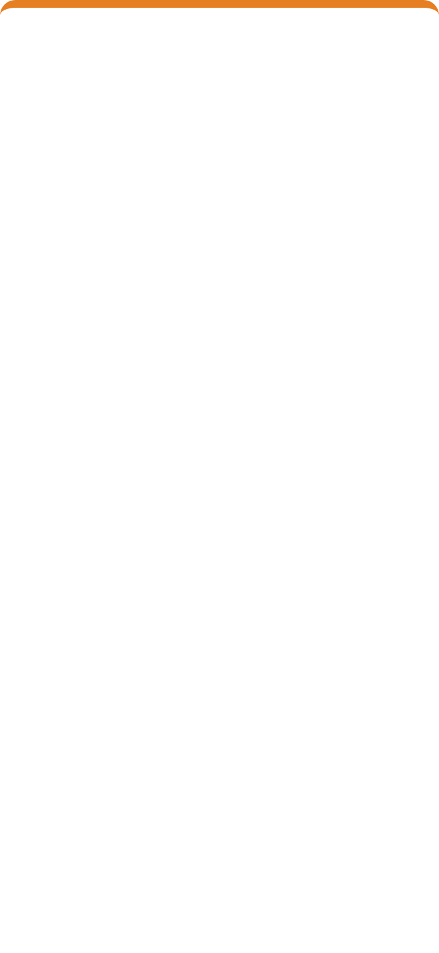
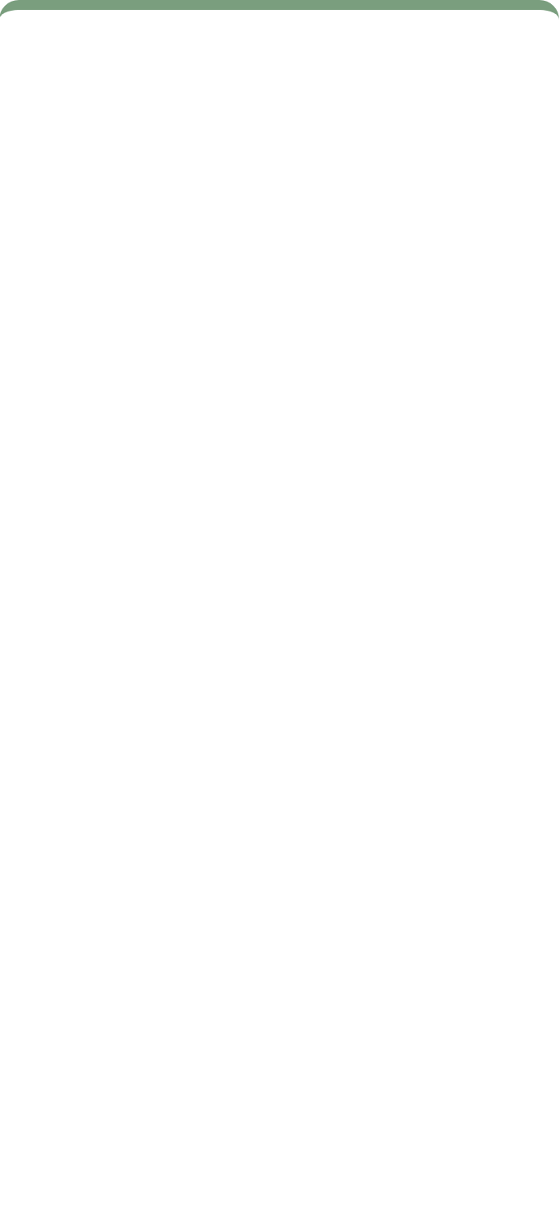
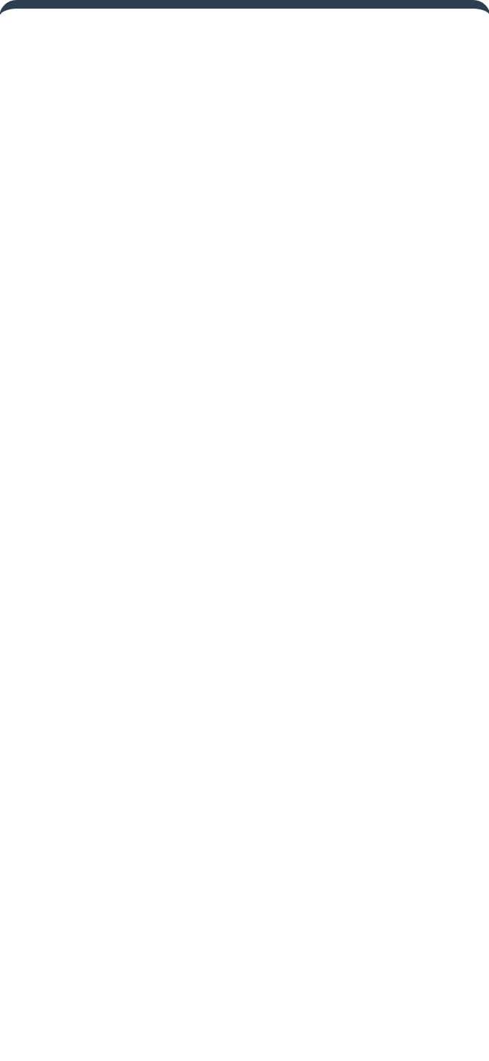
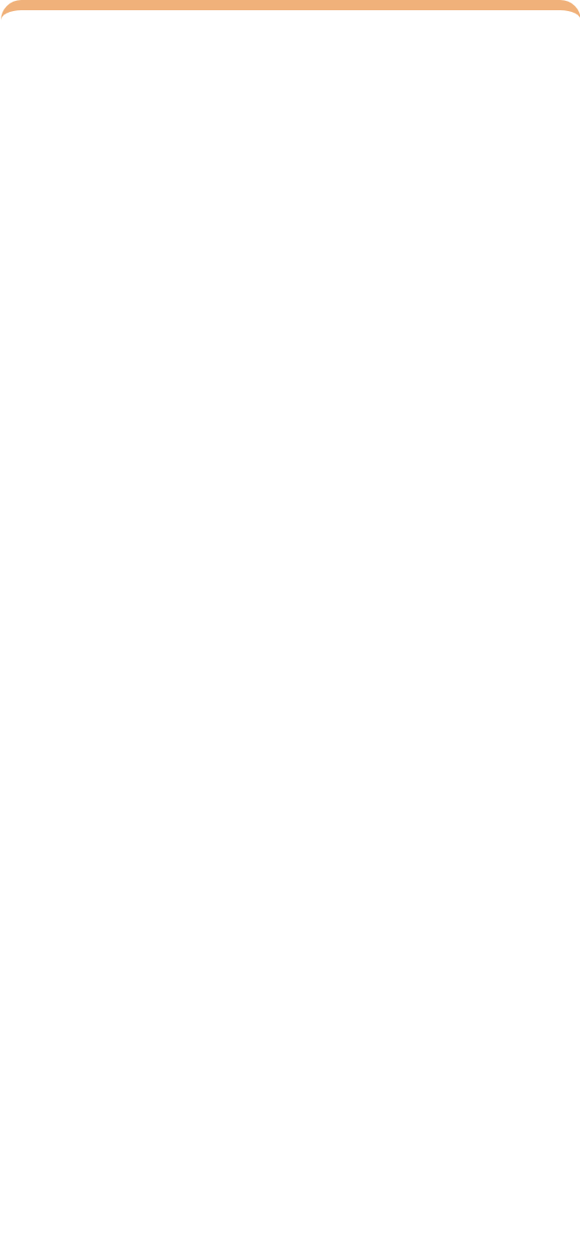
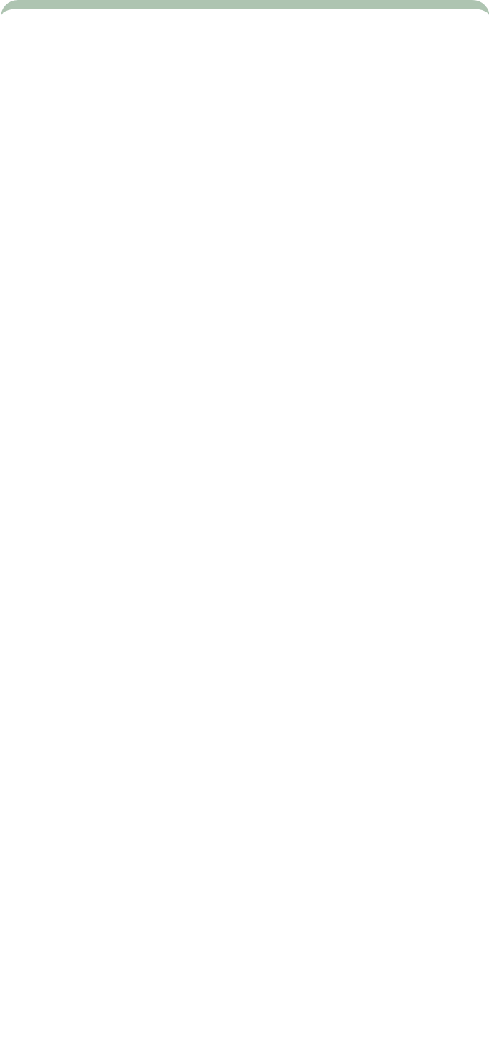


























Business Insights - Persona Characteristics
VIPs
Potentials
Standard
Impulsive
Savers
High Income, High Spend
High Income, Low Spend
Mid Income, Mid Spend
Low Income, High Spend
Low Income, Low Spend
High purchasing power
High purchasing power
Reliable average customer
Young or credit-driven
Cautious spenders
Loyal spenders
Low engagement
Heavy spender
Essential shoppers
Premium seekers
Missed opportunity
Forms bulk of traffic
Sales-reactive
Budget conscious
Brand advocates
Quality & prestige focus
Brand aware
App notifications work
Value-focused
General campaigns work
These personas reveal distinct spending behaviors that can be targeted with specific marketing strategies

Slide 20











Deployment - Actionable Marketing Strategies
Targeted strategies for each customer segment to optimize marketing spend and improve business outcomes:
VIPs
Standard
Strategy: Maintenance
Strategy: Retention
Keep engaged with general brand awareness campaigns
Deploy exclusive loyalty programs
Provide regular updates on new arrivals
Offer VIP concierge services
Maintain consistent communication
Provide personalized shopping experiences
Impulsive
Savers
Strategy: Conversion
Strategy: Inventory Clearence & Basics
Target with limited-time discount notifications
Focused on discount campaigns.
Use mobile app for timely offers
This group is highly price-sensitive and needs-driven. Focus on affordability, essential products, and aggressive discounts to clear old inventory.
Create urgency with time-sensitive promotions
Potentials
Strategy: Acquisition
Launch campaigns focused on "Quality" and "Prestige"
Highlight premium offerings and services
Personalized strategies based on customer behavior, not just demographics
Convert high income into mall spending

Slide 21



Deployment - Implementation Recommendations
Specific tactical approaches for each customer segment:
VIPs
Potentials
Strategy: Retention
Strategy: Acquisition
Deploy exclusive loyalty programs
Focus on "Quality" and "Prestige"
Offer VIP concierge services
Convert high income into mall spending
Impulsive
Standard
Strategy: Conversion
Strategy: Maintenance
Target with limited-time discounts
General brand awareness campaigns
Use mobile app for notifications
Keep engaged with regular updates
Savers
Strategy: Inventory Clearence & Basics
Personalized approaches yield better results than mass marketing
Hard Discount Coupons: Distribute high-percentage discount coupons (e.g., "50% Off")
3-for-2" Bundles: Use "Buy 2 Get 1 Free" campaigns on basic items

Slide 22








Business Impact & ROI (Return on Investment)
Expected Outcomes
Strategic Impact
Optimized Marketing Spend
Target the right message to the right person, reducing waste on irrelevant offers
Data Collection
Segmentation
Personalized
ROI
Customer Segmentation ROI Journey
Reduced Customer Churn
Identify at-risk customers and implement targeted retention strategies
Increased Revenue
Convert more customers through personalized recommendations and targeted offers
The K-Means model identified 5 clear segments with a valid Silhouette Score of 0.55, enabling precise customer targeting
This project demonstrates how data science transforms raw numbers into strategic power, providing the mall with a clear roadmap to reduce churn and increase revenue through personalization.

Slide 23




















Project Summary & Key Achievements
CRISP-DM Implementation
Key Achievements
Business Understanding
Identified inefficiency in marketing spend
Validated Customer Segments
Actionable Personas
Data Understanding
Successfully identified 5 clear customer segments with a Silhouette Score of 0.55, confirming mathematical distinctiveness
Translated mathematical clusters into 5 business personas: VIPs, Potentials, Standard, Impulsive, and Savers
Selected Annual Income and Spending Score
Data Preparation
Cleaned feature matrix with pandas
Modeling
K-Means clustering with 5 clusters
Targeted Strategies
Business Impact
Evaluation
Silhouette Score of 0.55
Developed specific marketing approaches for each segment, including retention for VIPs, acquisition for Potentials, and conversion for Impulsives
Provided mall with a roadmap to optimize marketing spend by targeting the right message to the right person, reducing churn and increasing revenue
Deployment
Actionable marketing strategies
Conclusion
In this project, we aimed to solve the inefficiency of random marketing. By applying the K-Means clustering algorithm, we discovered that our customer base is not uniform but consists of 5 distinct personas—from high-spending 'VIPs' to price-sensitive 'Budget' shoppers.
This segmentation provides a clear roadmap for the mall management. We have proven that data science is not just about coding; it is a strategic tool that lowers costs, increases customer retention, and drives revenue. We are now ready to deploy these strategies to turn potential into profit.

Slide 24
Thank You.
Any Questions?

